Slide 1
AP US History
2017- 2018

Slide 2
AP American History!!
Books to read
“A People’s History of the United States”- H. Zinn
“The Lies My Teacher Told Me”- J. Loewen
“Barron's AP United States History”
“The American Pageant”- Kennedy& Cohen (text book)
AP Test
May 11th
50 Multiple Choice
1 DBQ
1 FRQ
4 Short Answers Questions
AP Class
Quiz are all short answer
Tests are all Multiple Choice
Will do one DBQ or FRQ a month
AP Information
This class does have PP --- test and quizzes are not based on PP.
The text book and your assigned reading will be what you are tested and quizzed over.
AP Grading Scale
Test- 40%
Quiz- 30%
Homework- 15%
Classwork- 15%
AP vs SOL
You are still going to have to take the VA/US SOL
They are two different test
AP- is looking for advanced thing and your ability to look at history thought many perspectives.
In AP the more you know and the better you can write the better your score will be
SOL- is looking for information that you were spoon feed and no writing
AP
Any student who scores Higher than a three on AP test can get college credit for this class. (the highest score is a 9)
Writing is a major factor on this test and in this class. Please always take your time and write clear and to the point!
KNOW YOUR SFI (Specific, Factual Information)

Slide 3
Reading
Assignment
New World Beginnings (33,000 BC to 1769)
The Planting of English America (1500 to 1733
Ch.1(pg. 4)
Ch. 2(pg. 24)
Settling the Northern Colonies (1619 to 1700)
American Life in the 17th Century (1607 to 1692)
Ch.3(pg. 41)
Ch. 4(pg. 60)
PowerPoint
Colonial Society on the Eve of Revolution (1700 to1775)
The Duel for North America (1608 to 1763)
Ch.5(pg. 78)
Ch. 6(pg. 98)
PowerPoint
The Confederation and Constitution (1776 to 1790)
Ch.7(pg. 158)
Ch.8
Review!
Ch.6 to 8 Test
1608to 1783

Slide 4
Reading
Assignment
Launching the New Ship of State (1789 to 1800)
The Triumphs and Travail of the Jeffersonian Republic (1800 to 1812)
Ch.9(pg. 158)
Ch.10(pg. 180)
Review!
The Second War For Independence and Upsurge of Nationalism (1812 to 1824)
The Rise of a mass Democracy (1824 to 1840)
Ch. 11(pg. 202)
Ch.12(pg. 224)
Review!
The Rise of a mass Democracy (1824 to 1840)
Ch.9 to 12 Test
1776 to 1812
Ch. 13(pg. 246)
The Rise of a mass Democracy (1824 to 1840)
Forging the national Economy (1790 to 1860)
Ch. 13(pg. 246)
Ch.14(276)
Review!
Drifting towards Disunion (1854 to 1861)
Ch. 14(pg. 246)
Ch.15(pg. 307)

Slide 5
Reading
Assignment
The Ferment of reform and Culture (17904 to 1860)
Ch. 14(pg. 246)
Ch.15(pg. 307)
The Ferment of reform and Culture (17904 to 1860)
The South and the Slavery Controversy (1793 to 1860)
Ch.15(pg. 307)
Ch. 16 (pg. 338)
Review!
Manifest Destiny and its Legacy (1841to 1848)
Renewing the Sectional Struggle (1841to 1854)
Ch.17 (pg. 360)
Ch. 18 (pg. 378)
Review!
Ch.13 to 19 Test
1790 to 1861
Ch.19 (pg. 396)
Drifting towards Disunion (1854 to 1861)
Ch.20 (pg. 418)
Review!

Slide 6
Reading
Assignment
Grinding for War: North and South (1861to 1865)
Grinding for War: North and South (1861to 1865)
The Furnace of War (1861to 1865)
Ch.20 (pg. 418)
Ch. 21 (pg. 435)
Review!
The Ordeal of Reconstruction (1865to 1877)
Ch.13 to 19 Test
1860 to 1877
Ch.22 (pg. 465)
Review!
Review!
Review!

Slide 7
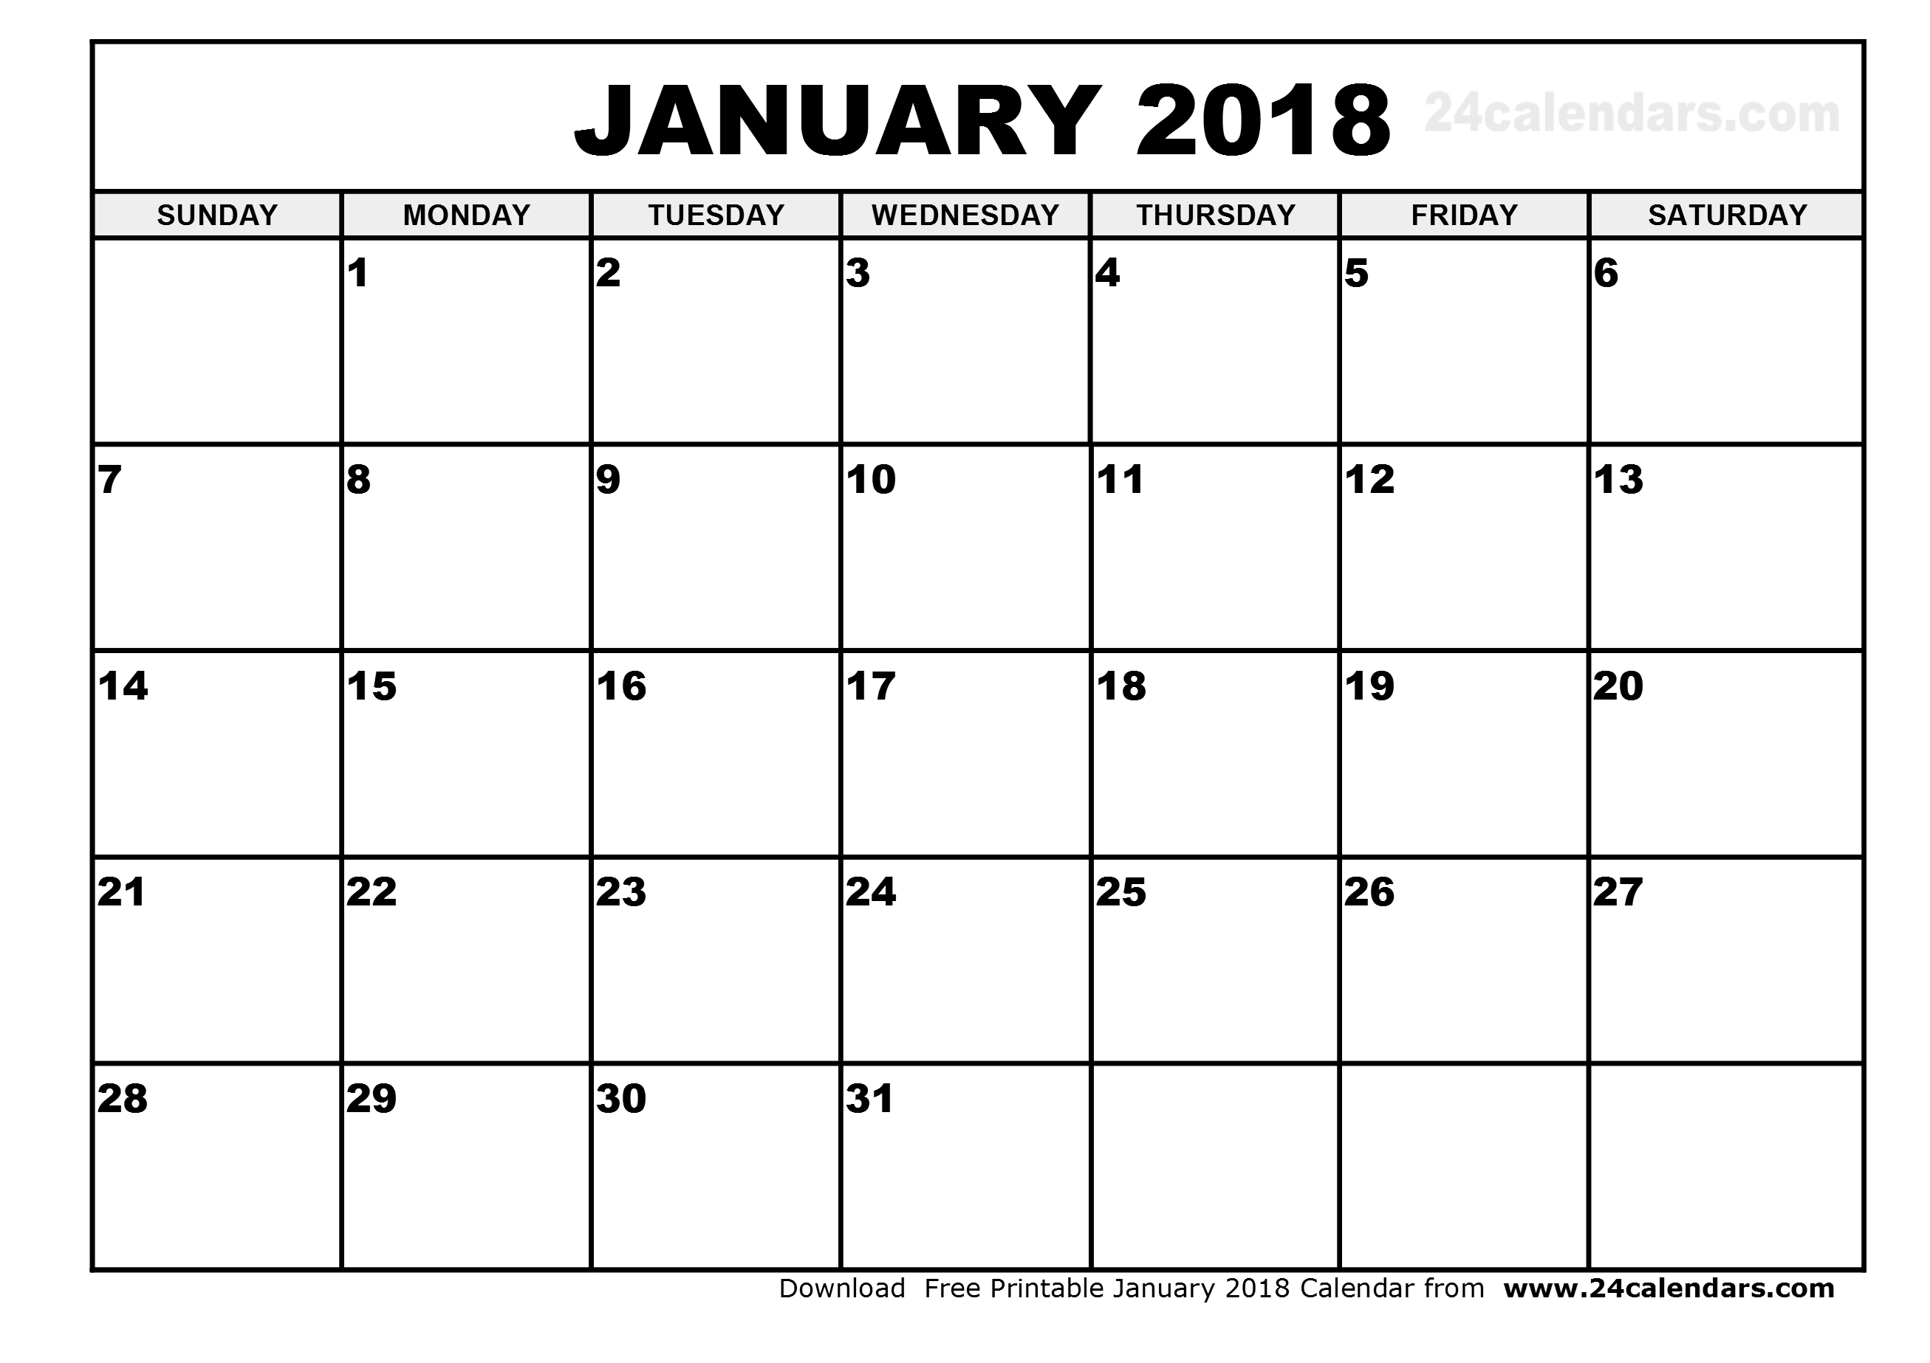
Reading
Assignment
Political Paralysis in the Gilded Age (1869to 1896)
Political Paralysis in the Gilded Age (1869to 1896)
Ch.23 (pg. 488)
Political Paralysis in the Gilded Age (1869to 1896)
Industry Comes of Age (1865to 1900)
Ch.23 (pg. 488)
Ch. 24(pg. 512)
Review!
Industry Comes of Age (1865to 1900)
Americans Moves to the city (1865to 1900)
Ch. 24(pg. 512)
Ch. .25 (pg. 539)
The Great West and the Agricultural Revolution (1865 to 1896)
Ch. 26(pg. 575)
Ch. .27 (pg. 608)
Empire and Expansion (1890to 1909)
Review!
Progressive and Republican Roosevelt (1901to 1912)
Ch. 28(pg. 638)
Ch. .29 (pg. 661)
Review!

Slide 8
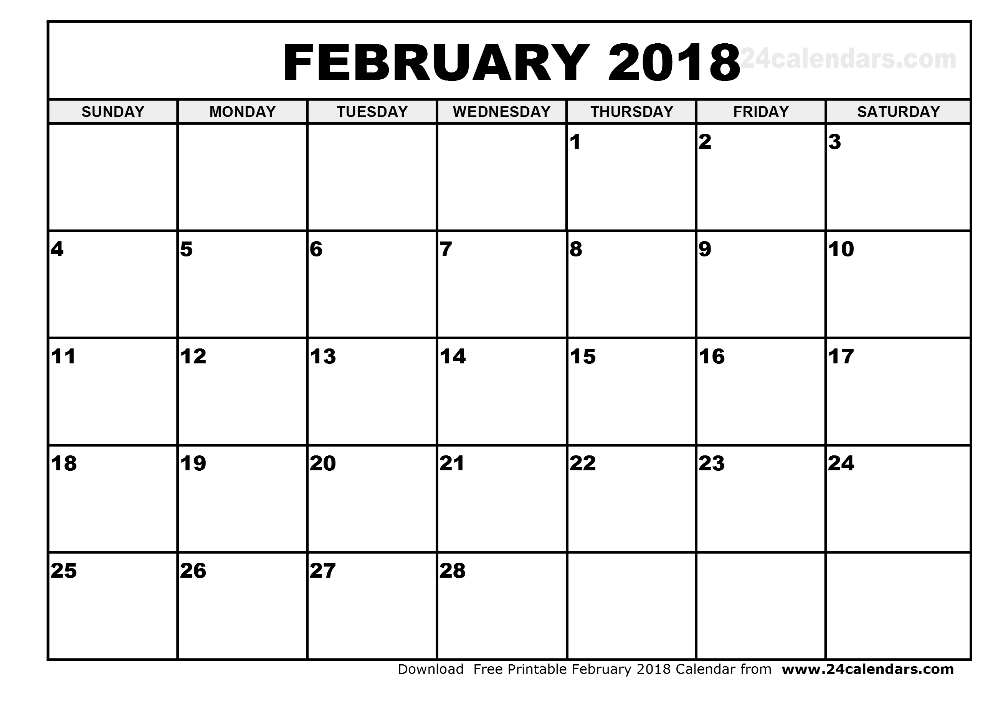
Reading
Assignment
Wilsonian Progressivism at home and Abroad (1912to 1916)
Ch. 28(pg. 638)
Ch. .29 (pg. 661)
Progressive and Republican Roosevelt (1901to 1912)
Ch.20 to 29 Test
1869 to 1918
Ch. 28(pg. 638)
Ch. .29 (pg. 661)
Review!
The War to End War (1917to 1918)
The War to End War (1917to 1918)
Ch. 30(pg. 638)
Review!
American Life in the “Roaring Twenties”(1919to 1929)
The War to End War (1917to 1918)
Ch. 30(pg. 638)
Ch. 31 (pg. 700)
American Life in the “Roaring Twenties”(1919to 1929)
Ch. 31 (pg. 700)
Ch. 32 (pg. 728)
Review!

Slide 9
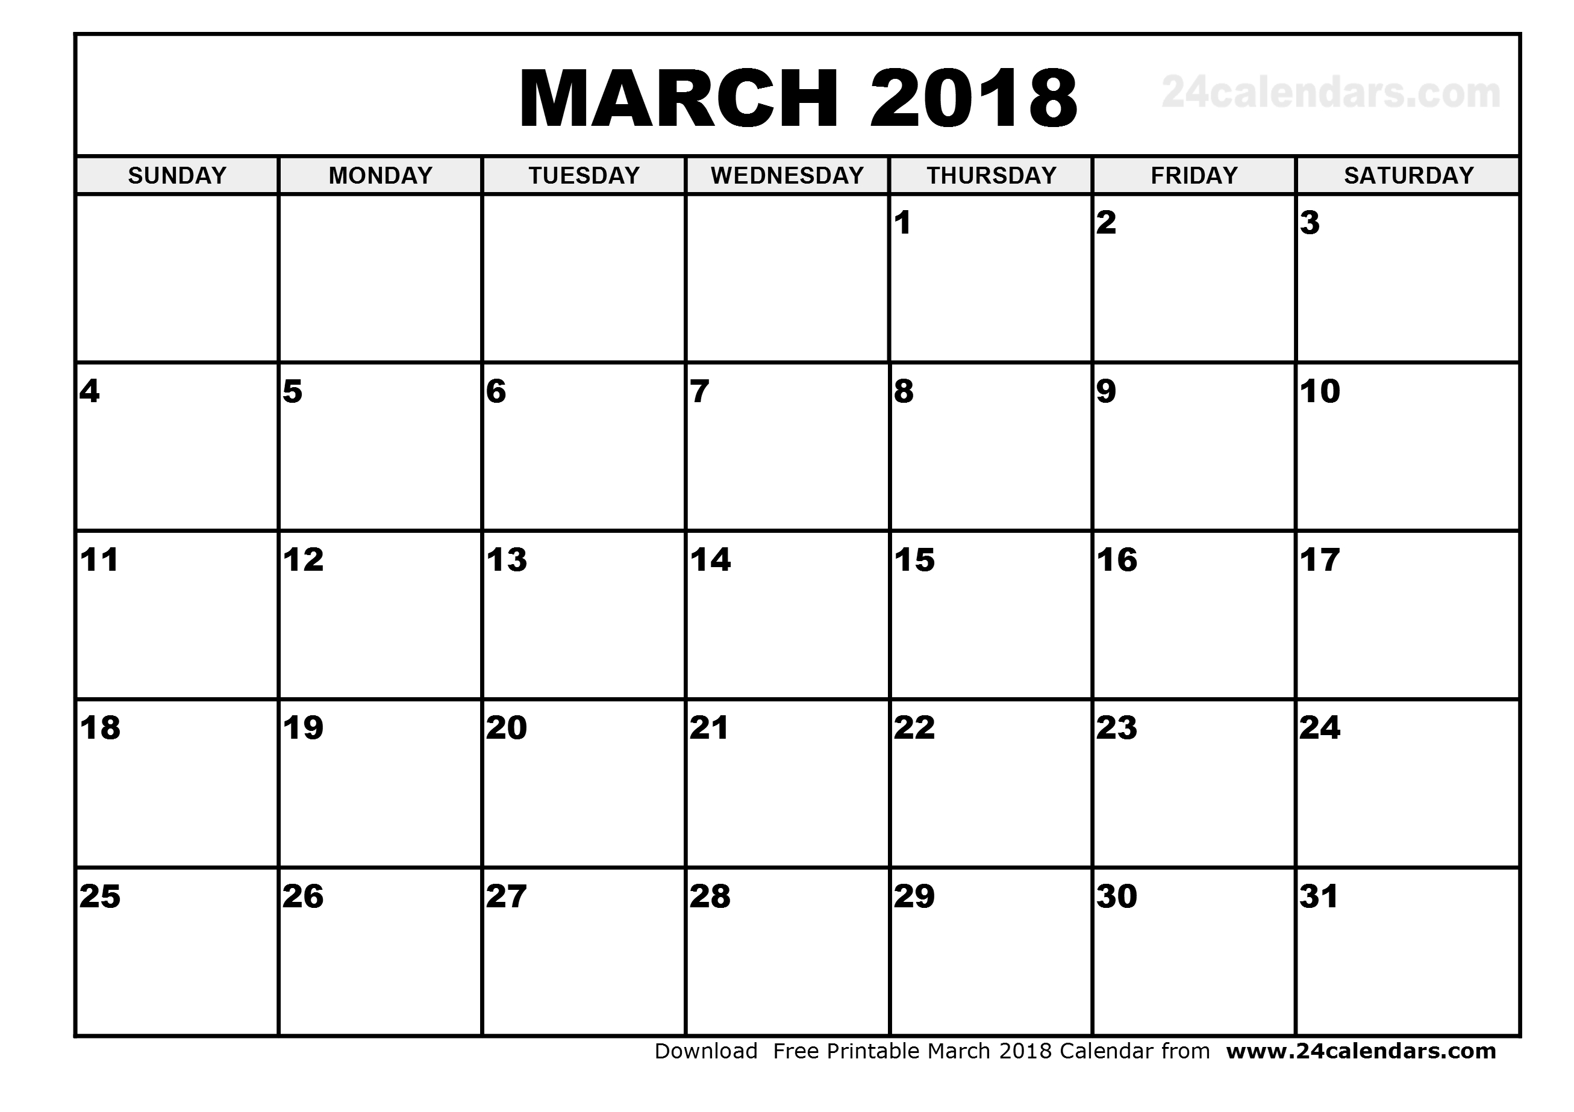
Reading
Assignment
The Politics of Boom and Bust (1920to 1929)
Ch. 31 (pg. 700)
Ch. 32 (pg. 728)
The Politics of Boom and Bust (1920to 1929)
The Great Depression and the New Deal (1929to 1940)
Ch. 32 (pg. 728)
Ch. 33 (pg. 751)
Review!
The Great Depression and the New Deal (1929to 1940)
Ch.30 to 33 Test
1917 to 1939
Ch. 33 (pg. 751)
Ch. 34 (pg. 778)
Review!
FDR and the Shadow of War (1933to 1941)
America in World War II (1941 to 1945)
Ch. 34 (pg. 778)
Ch.35 (pg. 798)
Review!
America in World War II (1941 to 1945)
America in World War II (1941 to 1945)
Ch.35 (pg. 798)
Review!

Slide 10
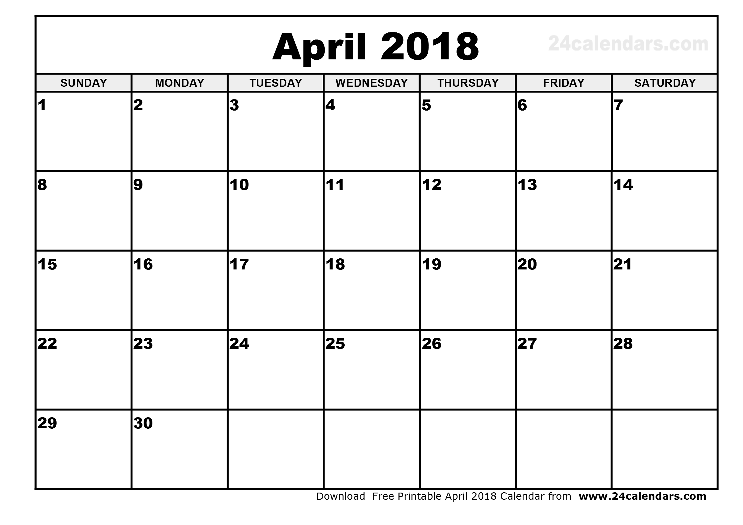
Reading
Assignment
Ch.34 to 35 Test
1939 to 1945
The Cold War Begins (1945 to 1954)
Ch.36 (pg. 798)
Ch. 37 (pg. 860)
Review!
The Eisenhower Era (1952 to 1960)
The Eisenhower Era (1952 to 1960)
Ch. 37 (pg. 860
Review!
The Stalemated Seventies (1970 to 1979)
The Resurgences of Conservatism (1980 to 1992)
The Stormy Sixties (1960 to 1969)
Ch.38 (pg. 889)
Ch. 39 (pg. 916)
The Resurgences of Conservatism (1980 to 1992)
Ch.40 (pg. 942)
Ch. 41 (pg. 965)

Slide 11
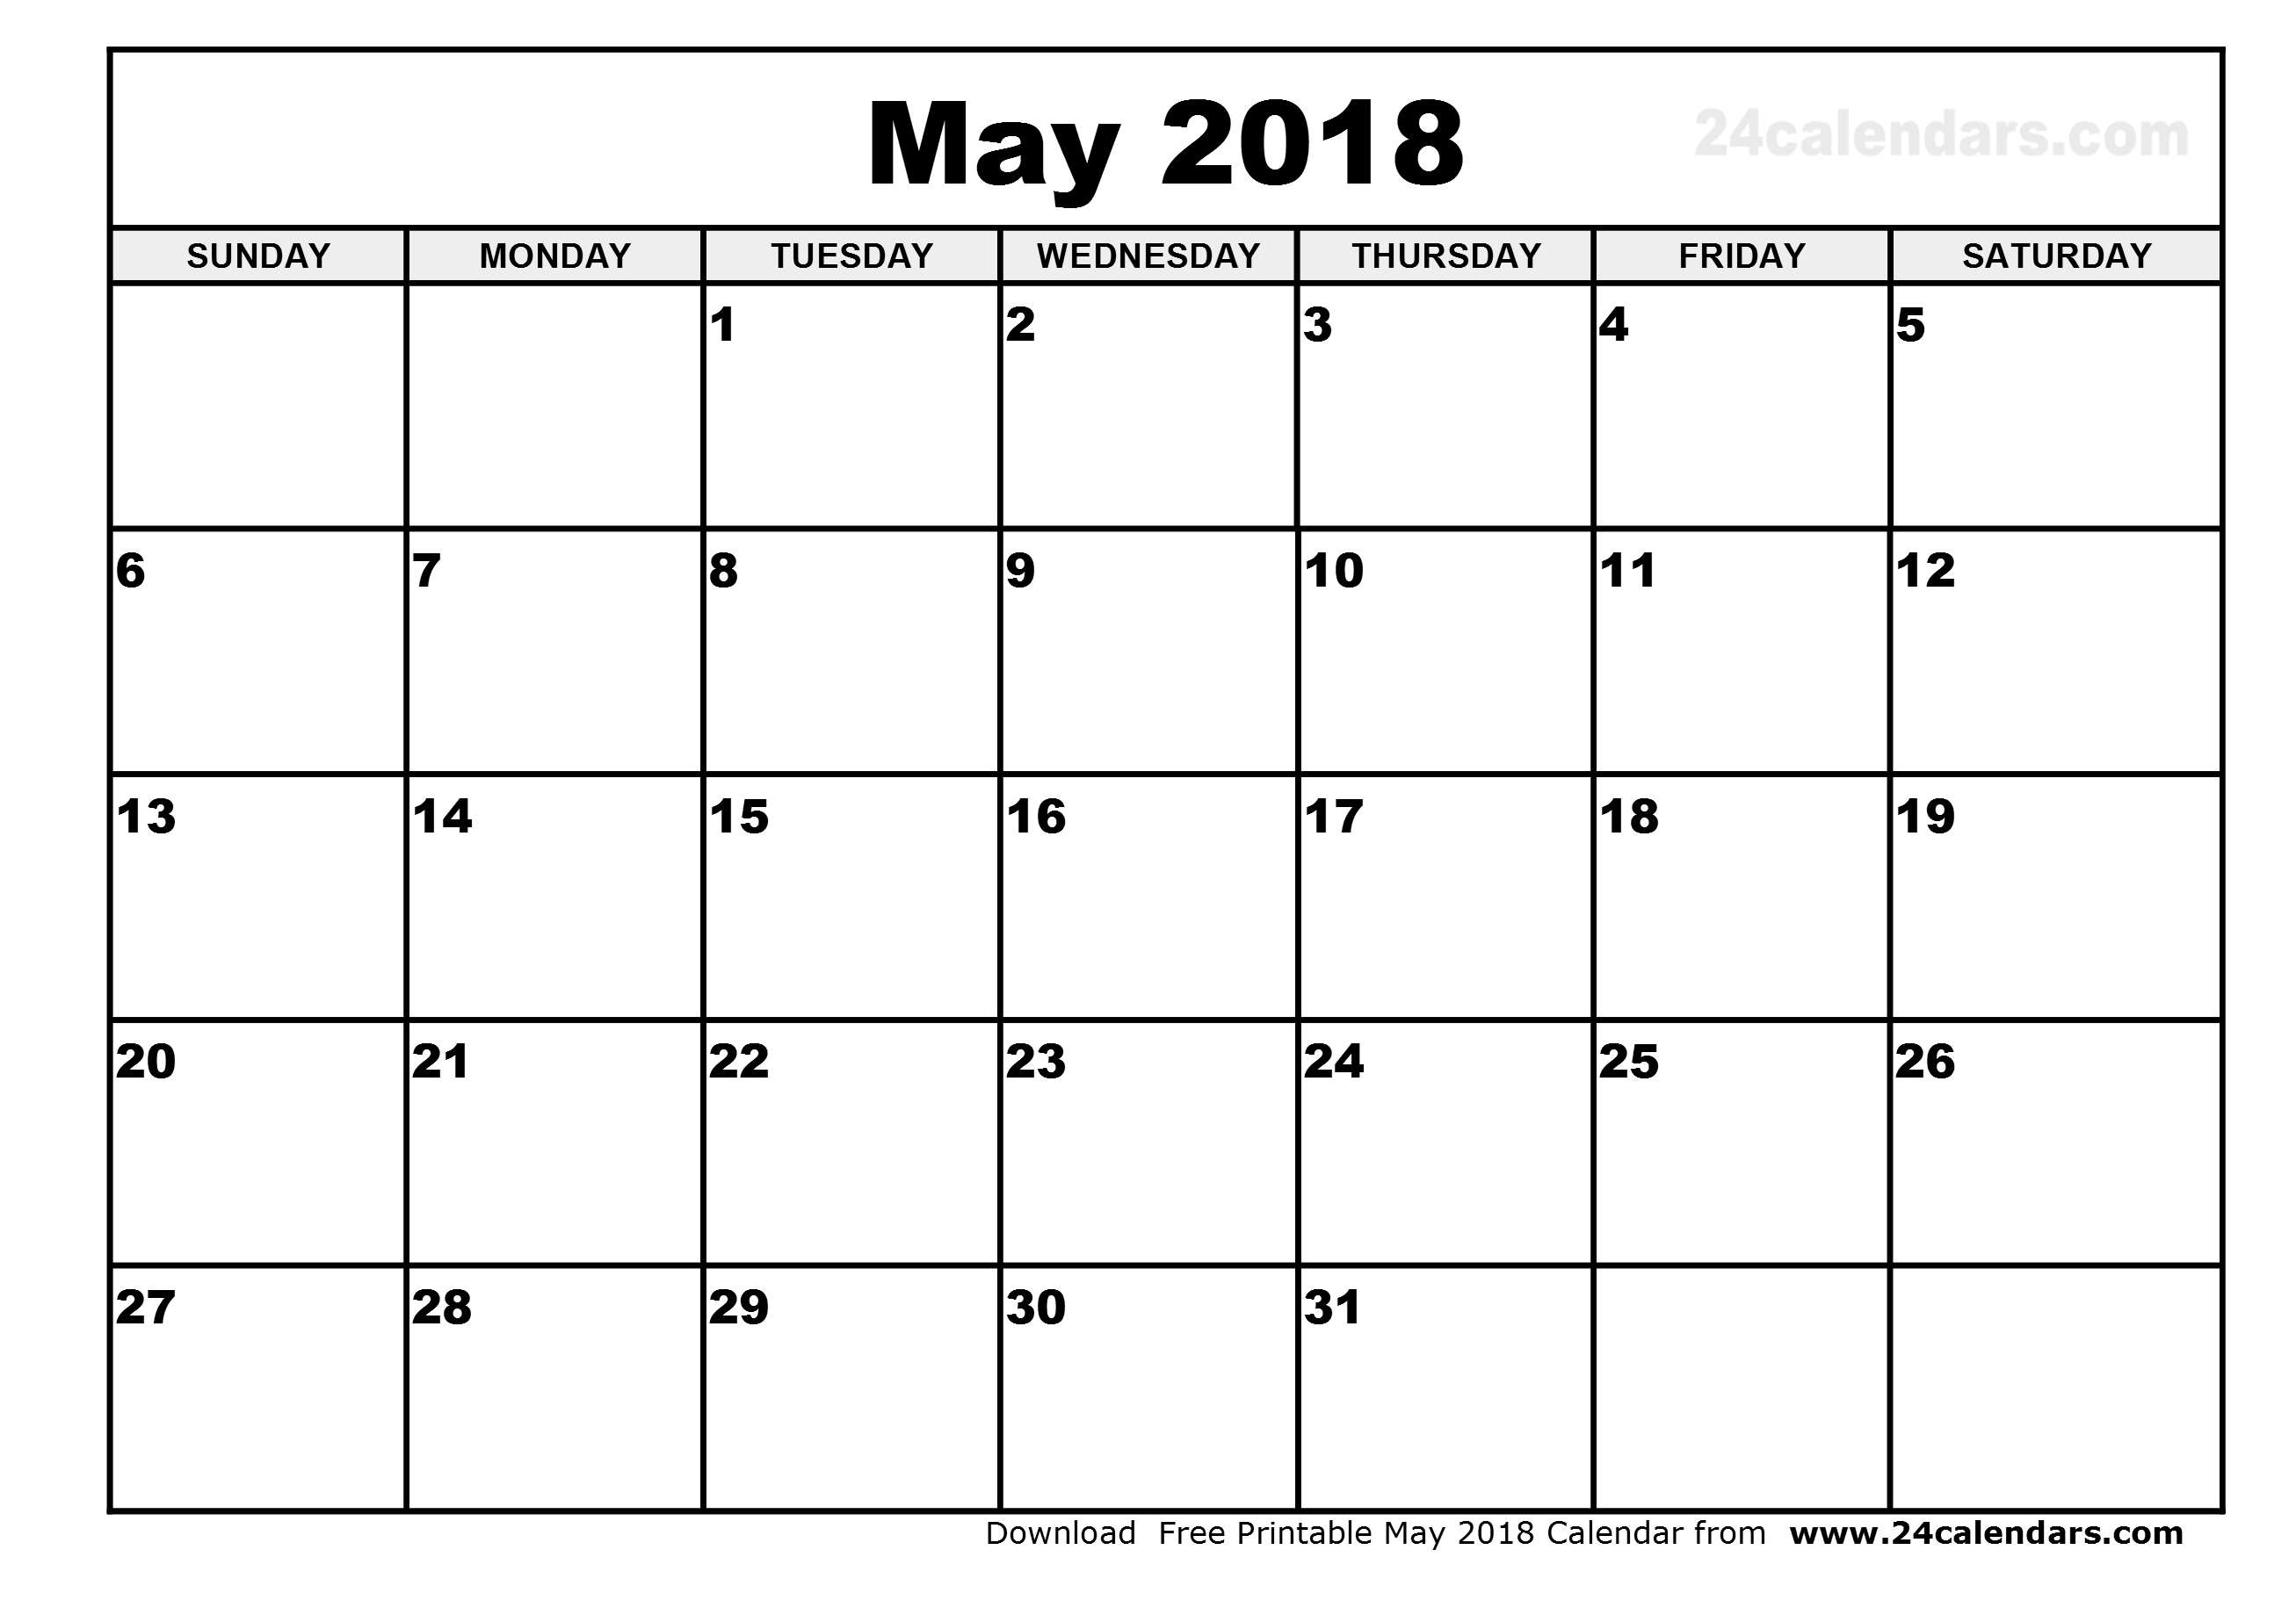
Reading
Assignment
America Confronts the Post Cold Era (1992 to 2011)
Ch.37 to 41 Test
1946 to 2008
Ch.40 (pg. 942)
Ch. 41 (pg. 965)
AP American History Test!!!!!!
Review!
Review!
SOL review
SOL review
SOL test

Slide 12
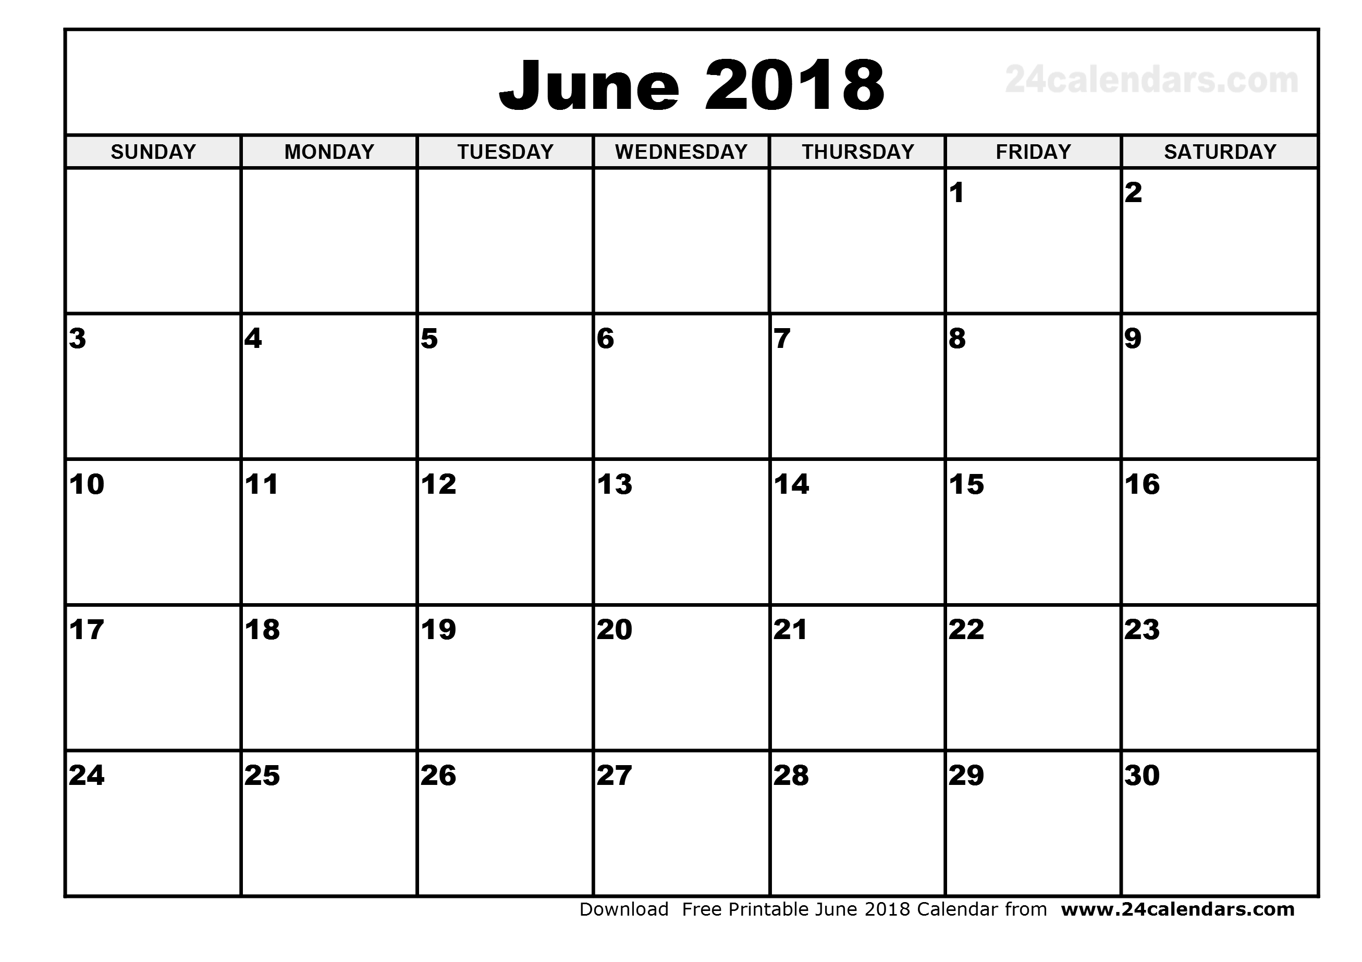
Graduation

