Slide 1
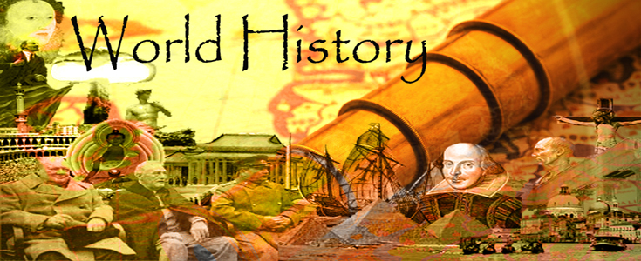
World History One SOL review!
Mind maps!

Slide 2
Early Man and Early Civilization
SOL #2-4

Slide 3
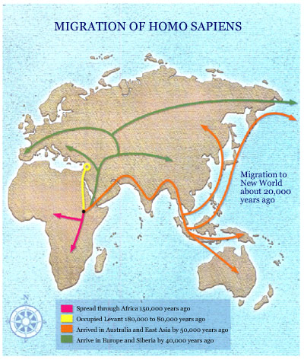
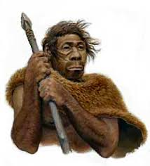
migrated from Africa to Eurasia, Australia, and the Americas
Homo Sapiens
East Africa 100,000 to 400,000 years ago
Early humans were hunters and gatherers
STANDARD WHI.2a
Life in early hunter-gatherer societies was shaped by their physical environment.

Slide 4
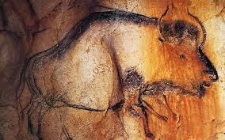
Early human societies, through the development of culture, began the process of overcoming the limits set by the physical environment.
were nomadic, migrating in search of food, water, shelter
STANDARD WHI.2b
invented the first tools, including simple weapons
created “cave art.”
learned how to make and use fire
lived in clans
Paleolithic Era (Old Stone Age)
developed oral language

Slide 5
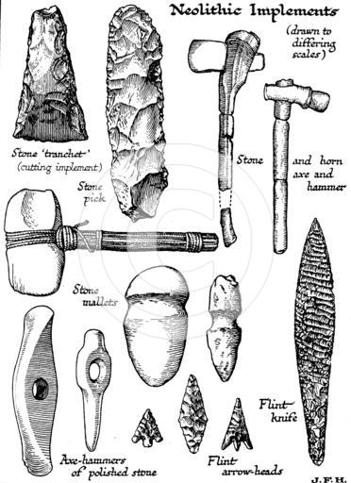
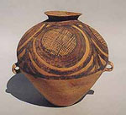
developed agriculture (domesticated plants and animals)
developed weaving skills
Neolithic Era (New Stone Age)
used advanced tools
made pottery
STANDARD WHI.2c
The beginning of agriculture, including permanent settlements, was a major step in the advance of civilization.

Slide 6
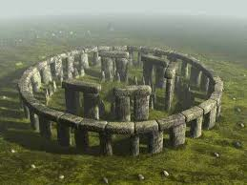
Archaeologists continue to find and interpret evidence of early humans and their lives.
Stonehenge is an example of an archaeological site in England
apply scientific tests, such as carbon dating, to analyze fossils and artifacts
STANDARD WHI.2d
Aleppo and Jericho are examples of early cities in the Fertile Crescent
study past cultures by locating and analyzing human remains, settlements, fossils, and artifacts
Çatalhöyük is an example of a Neolithic settlement currently under excavation in Anatolia
Archaeologists

Slide 7
Mesopotamian civilization: Tigris and Euphrates River Valleys
Indian civilization: Indus River Valley
River valley civilizations3500 to 500 b.c. [b.c.e.]
Egyptian civilization: Nile River Valley and Nile Delta
Chinese civilization: Huang He Valley
STANDARD WHI.3a
These river valleys offered rich soil and irrigation water for agriculture, and they tended to be in locations easily protected from invasion by nomadic peoples.
During the New Stone Age, permanent settlements appeared in river valleys and around the Fertile Crescent.

Slide 8
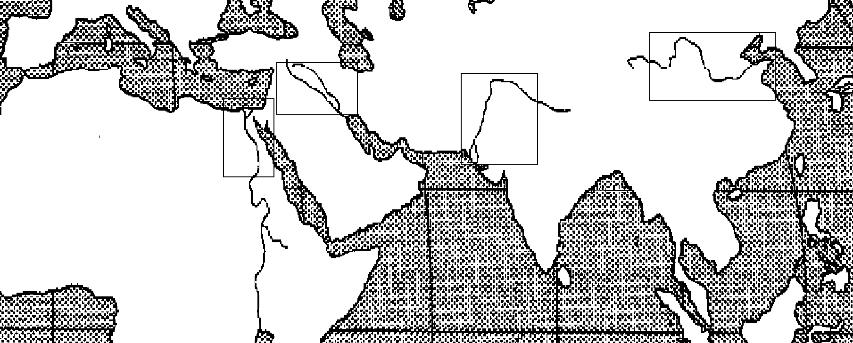
Mesopotamian
Civilization
Chinese
civilization
Egyptian
civilization
Indian
civilization
Indian Ocean

Slide 9
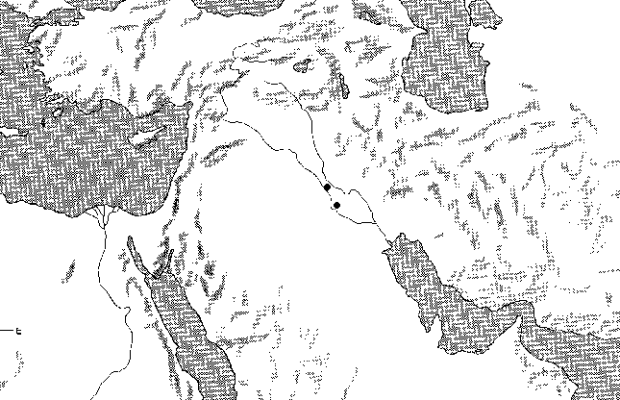
Black Sea
Asia Minor
(Anatolia)
the Fertile Crescent
Mesopotamia
Mediterranean Sea
Tigris River
Euphrates River
Nile River
Delta
Nile River
Arabian Peninsula
Notes:
Black Sea

Slide 10
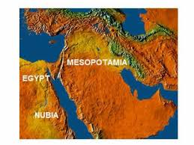
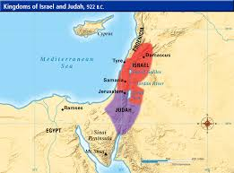
River valleys provided water and rich soil for crops as well as protection from invasion.
Nubia was located on the upper (southern) Nile River (Africa).
STANDARD WHI.3a
Hebrews settled between the Mediterranean Sea and the Jordan River Valley (part of Fertile Crescent in Southwest Asia).
Phoenicians settled along the Mediterranean coast (part of Fertile Crescent in Southwest Asia)
Other early civilizations (about 2000 to 500 b.c. [b.c.e.])

Slide 11
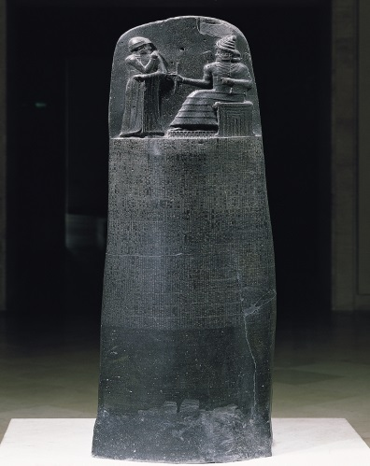
Rigid class system where slavery was accepted
Development of social patterns
Development of political patterns
World’s first states (i.e., city-states, kingdoms, empires)
Hereditary rulers: Dynasties of kings, pharaohs
STANDARD WHI.3b
Centralized government, often based on religious authority
River valleys were the “Cradles of Civilization.” Early civilizations made major contributions to social, political, and economic progress.
Written law codes (e.g., Ten Commandments, Code of Hammurabi)

Slide 12
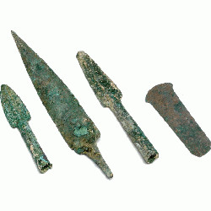
Increasing trade along rivers and by sea (Phoenicians)
Development of economic patterns
Development of the world’s first cities
Increasing agricultural surplus: Better tools, plows, irrigation
Development of the practice of slavery within most cultures in the ancient world, taking various forms
STANDARD WHI.3b
Use of metal (e.g., bronze, iron) tools and weapons
River valleys were the “Cradles of Civilization.” Early civilizations made major contributions to social, political, and economic progress.

Slide 13
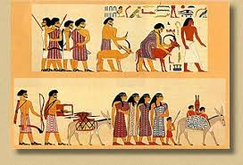
Religion was a major part of life in all early civilizations.
STANDARD WHI.3c
Monotheism was practiced by the Hebrews.
Development of religious traditions
Polytheism was practiced by most early civilizations.

Slide 14
The monotheism of Abraham became the foundation of Judaism, Christianity, and Islam—religions that changed the world. The Hebrews were the first to become monotheists.
Abraham- Father of Judaism
Moses- lead Hebrews on Exodus out of Egypt
Jerusalem- Capital city- Temple to God
Origins of Judaism
Spread of Judaism
Exile- to Babylon
Diaspora- the spreading
STANDARD WHI.3d
Torah, which contains the written records and beliefs of the Jews
Beliefs, traditions, and customs of Judaism
Ten Commandments, which state moral and religious conduct
Belief in one God (monotheism)

Slide 15
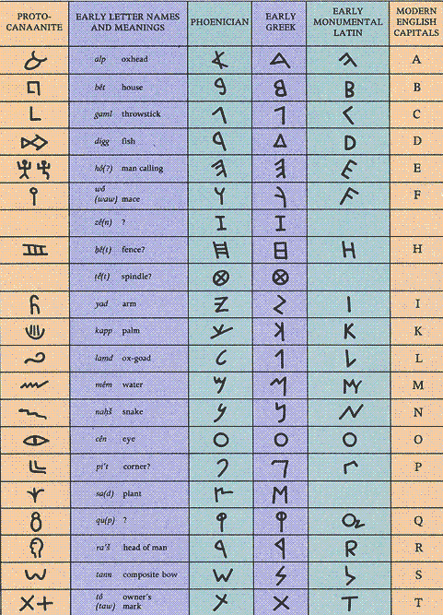
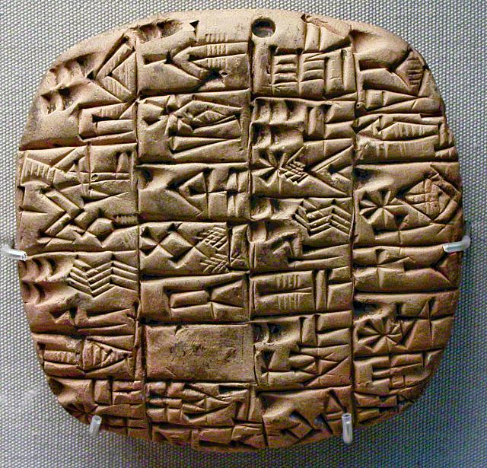
Pictograms: Earliest written symbols
Language and writing
Hieroglyphics: Egypt
Cuneiform: Sumer
STANDARD WHI.3e
Alphabet: Phoenicia
Language and writing were important cultural innovations.

Slide 16
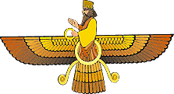
Built on earlier Central Asian and Mesopotamian civilizations, Persia developed the largest empire in the world.
Zoroastrianism was the main Persian religion, although other religions were tolerated
STANDARD WHI. 4a
Construction of road system
Practice of Zoroastrianism
Religion of Persia
Belief in two opposing forces in the universe- Good vs Evil
Persian Empire
Tolerance of conquered peoples
Development of an imperial bureaucracy

Slide 17
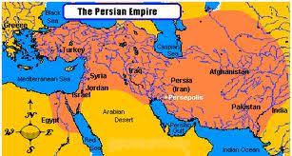

Slide 18
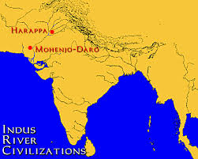
Physical barriers, such as the Himalayas, the Hindu Kush, and the Indian Ocean, made invasion difficult.
Mountain passes in the Hindu Kush provided migration routes into the Indian subcontinent.
Physical geography of India
Classical Indian civilization began in the Indus River Valley, spread to the Ganges River Valley, and then spread throughout the Indian subcontinent. This spread continued with little interruption because of the geographic location.
The Indus and Ganges were the important rivers in the Indian subcontinent.
STANDARD WHI.4b
Harappa and Mohenjo-Daro- Earliest cities in India
Indus River Valley civilization

Slide 19
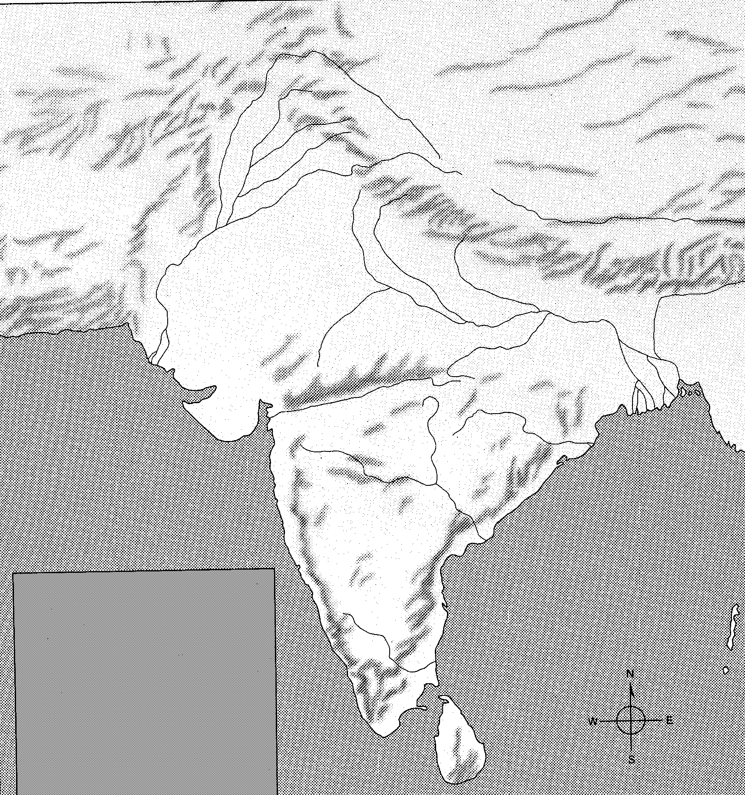
Himalayas
Hindu Kush
Indus River
Harappa
Ganges River
Mohenjo-Daro-
Indian Ocean

Slide 20
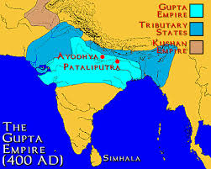
-Migration, assertion of dominance
-Caste system, which influenced all social interactions and choices of occupations
-Golden Age of classical Indian culture
-Contributions: Mathematics (concept of zero), medical advances (setting bones), astronomy (concept of a round earth), new textiles, literature
Aryans (Indo-Aryans)
Mauryan Empire - Asoka
STANDARD WHI .4b
Gupta Empire
Indo-Aryan people migrated into the area, creating a structured society (caste system) and blending their beliefs with those of the indigenous people.
-Continued political unification of much of India
-Contributions: Spread of Buddhism, free hospitals, veterinary clinics, good roads
During the Golden Age of classical Indian culture, Indian people made significant contributions to world civilization.

Slide 21
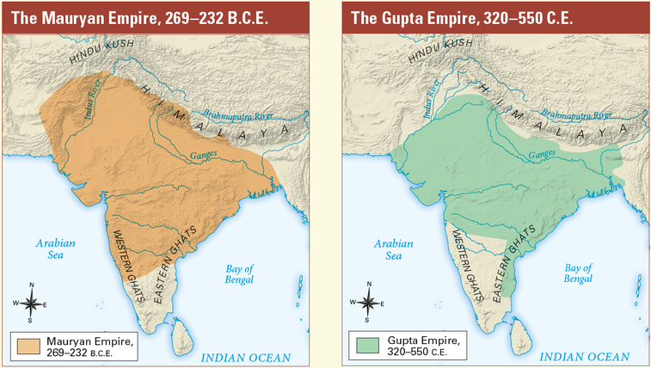

Slide 22
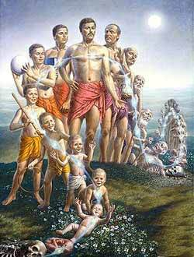
Karma: Knowledge that all thoughts and actions result in future consequences
Belief in many forms of one God
Hinduism
Vedas and Upanishads: Sacred writings
Reincarnation: Rebirth based upon karma
STANDARD WHI.4c
Spread along major trade routes
Hinduism was an important contribution of classical India.
Hinduism influenced Indian society and culture and is still practiced in India today.

Slide 23
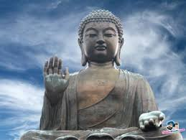
Buddhism was founded by Siddhartha Gautama in a part of India that is in present-day Nepal.
Buddhism became a major faith when Asoka sent missionaries throughout Asia.
Founder: Siddhartha Gautama (Buddha)
STANDARD WHI.4d
Eightfold Path to Enlightenment
Asoka’s missionaries and their writings spread Buddhism from India to China and other parts of Asia.
Buddhism
Four Noble Truths

Slide 25
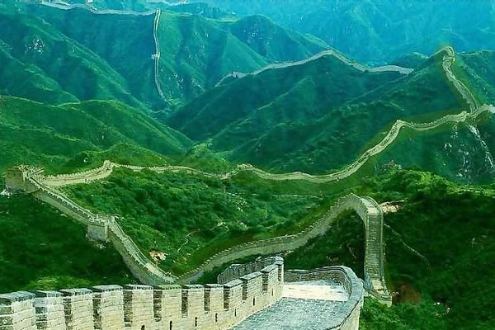
China was governed by a succession of ruling families called dynasties. Chinese rulers were considered divine, but they served under a Mandate of Heaven only as long as their rule was just.
The Silk Road facilitated trade and contact between China and other cultures as far away as Rome.
Early China
Contributions of classical China
Civil service system
Paper
Porcelain
Silk
Migratory invaders raided Chinese settlements from the north. Qin Shi Huangdi built the Great Wall as a line of defense against invasions.
STANDARD WHI.4e
Classical China was centered on the Huang He (Yellow River) and was geographically isolated. Invaders entered China from the north. The Great Wall was built for China’s protection.

Slide 26
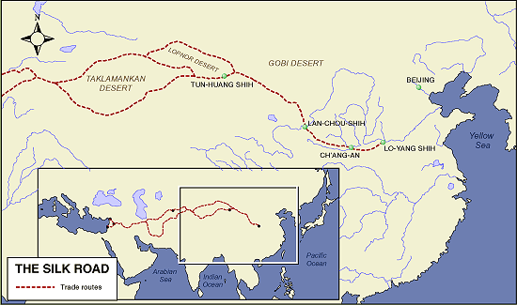

Slide 27
Impact of Taoism in forming Chinese culture and values
Chinese culture began around 1500 b.c. (b.c.e.). Of Chinese contributions to civilization, Confucianism and Taoism are among the most noted.
Taoism
Yin and yang represented opposites for Confucianism and Taoism.
Chinese forms of Buddhism spread throughout Asia.
Humility
Simple life and inner peace
Harmony with nature
STANDARD WHI.4f
Belief that humans are good, not bad
Respect for elders
Code of politeness (still used in Chinese society today)
Emphasis on education
Ancestor worship
Impact of Confucianism in forming the social order in China
Confucianism

Slide 28
The Greeks!
SOL #5

Slide 29
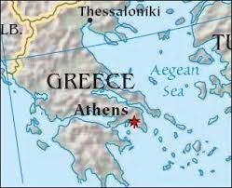
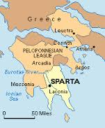
Aegean Sea
Balkan and Peloponnesus peninsula­, Europe, Asia Minor
Physical geography of the Aegean Basin
Mediterranean Sea
Black Sea, Dardanelles
Athens, Sparta, Troy
Macedonia
STANDARD WHI.5a
The physical geography of the Aegean Basin shaped the economic, social, and political development of Greek civilization.

Slide 30
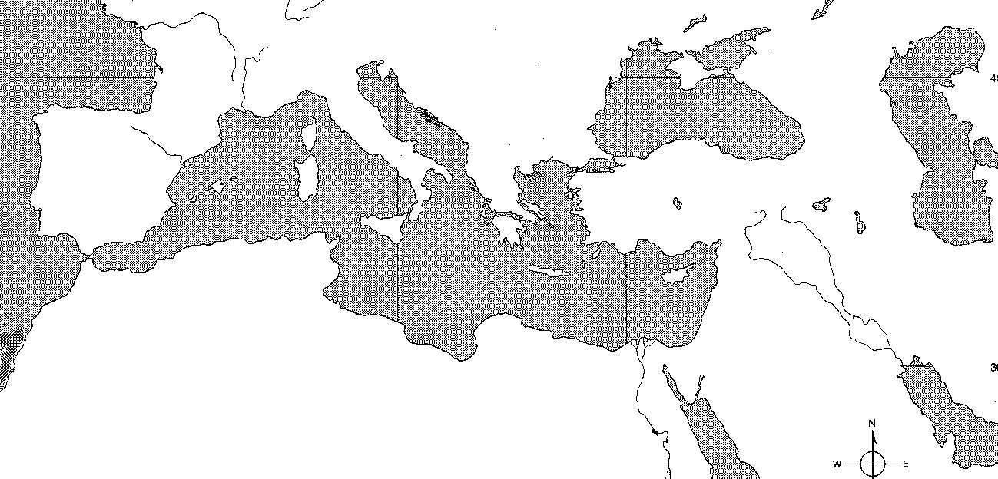
Europe
Alps
Mountain
Black
Sea
Balkan
Peninsula
Dardanelles
Asia Minor
Aegean
Sea
Phoenicia
Mesopotamia
Tigris
River
Mediterranean Sea
Euphrates
River
Asia
Hebrews
Arabian
Peninsula
Nile River
Africa

Slide 31
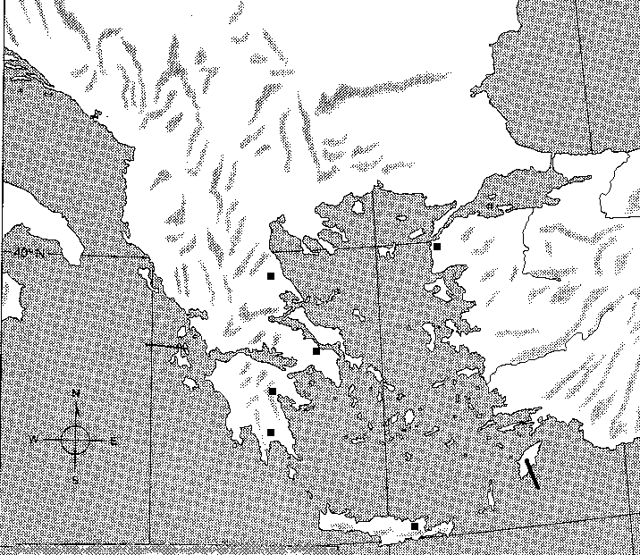
Balkan peninsula
Black Sea
Macedonia
Dardanelles
Troy
Aegean Sea
Asia Minor
Peloponnesus
peninsula
Athens
Sparta
Mediterranean Sea

Slide 32
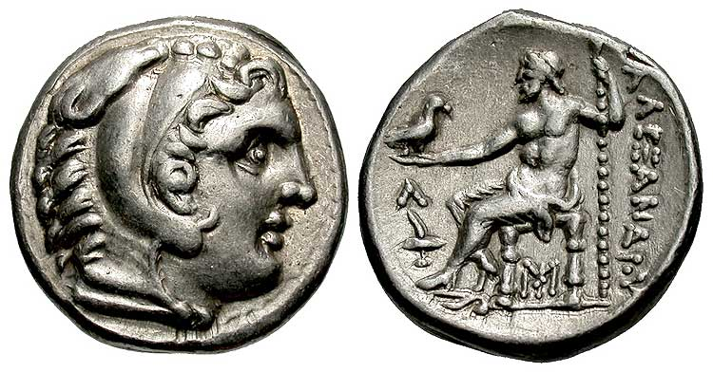
Mountainous terrain both helped and hindered the development of city-states.
The physical geography of the Aegean Basin shaped the economic, social, and political development of Greek civilization.
The expansion of Greek civilization through trade and colonization led to the spread of Hellenic culture across the Mediterranean and Black seas
Political development
Greek cities were designed to promote civic and commercial life.
Colonization was prompted by overpopulation and the search for arable land.
STANDARD WHI.5a
Agriculture (limited arable land)
Commerce and the spread of Hellenic culture
Economic and social development
Shift from barter to money economy (coins)

Slide 33
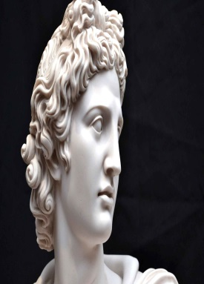
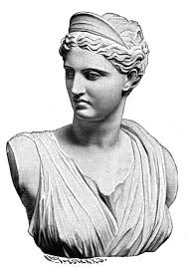
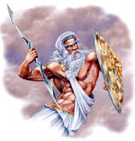
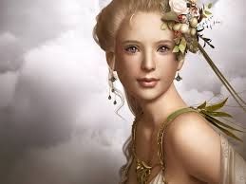
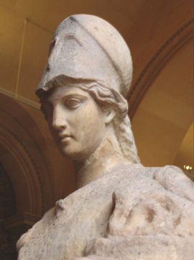
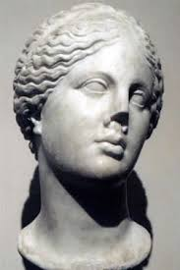
Based on polytheistic religion
Symbols and images in Western literature, art, and architecture
Greek mythology
Offered explanations of natural phenomena, human qualities, and life events
Zeus, Hera, Apollo, Artemis, Athena, Aphrodite
STANDARD WHI.5b
Greek mythology was based on a polytheistic religion that was integral to culture, politics, and art in ancient Greece.
Many of Western civilization’s symbols, metaphors, words, and idealized images come from ancient Greek mythology.
Goddess Hunt
God light
King of gods
Goddess
Childbirth
Goddess wisdom
Goddess love

Slide 34
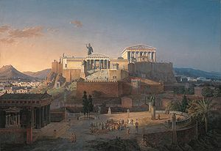
Classical Athens developed the most democratic system of government the world had ever seen, although not everyone could participate in decision making. It became a foundation of modern democracies.
Women and foreigners had no political rights.
STANDARD WHI.5c
Citizens (free adult males) had political rights and the responsibility of civic participation in government.
Social structure and citizenship in the Greek polis
Slaves had no political rights

Slide 35
Stages in the evolution of Athenian government: Monarchy, aristocracy, tyranny, democracy
Athens
Tyrants who worked for reform: Draco, Solon
Classical Athens developed the most democratic system of government the world had ever seen, although not everyone could participate in decision making. It became a foundation of modern democracies.
Contrasting philosophies of government divided the Greek city-states of Athens (democracy) and Sparta (oligarchy).
Origin of democratic principles: Direct democracy, public debate, duties of the citizen
STANDARD WHI.5c
Oligarchy (rule by a small group)
Rigid social structure
Sparta
Militaristic and aggressive society

Slide 36
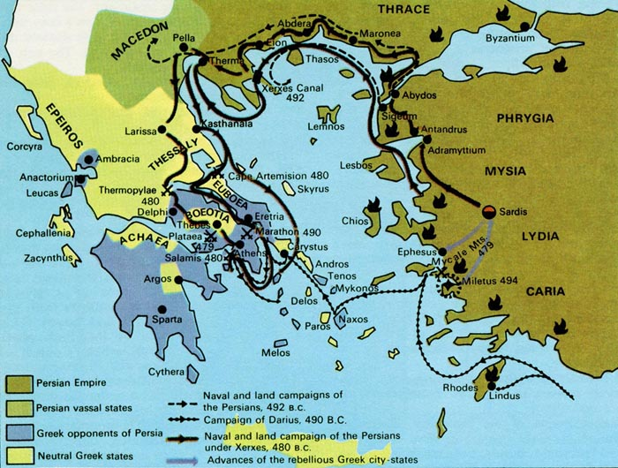
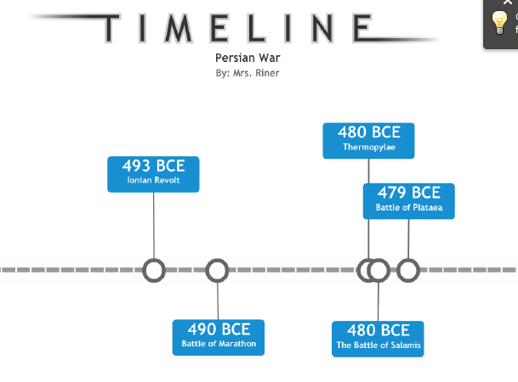
Persian wars united Athens and Sparta against the Persian Empire.
Importance of Persian Wars (499–449 b.c. [b.c.e.])
Athens preserved its independence and continued innovations in government and culture.
Athenian victories over the Persians at Marathon and Salamis left Greeks in control of the Aegean Sea
The Greeks defeated the Persian empire and preserved their political independence.
STANDARD WHI.5d

Slide 37
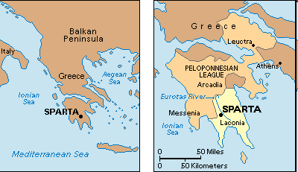
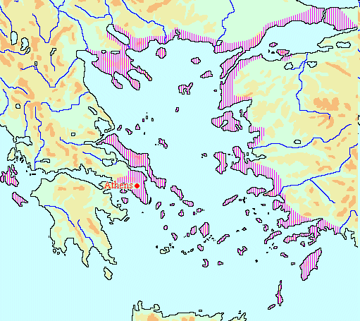
Competition between Sparta and Athens for control of Greece helped cause the Peloponnesian War.
STANDARD WHI.5d
Caused in part by competition for control of the Greek world: Athens and the Delian League versus Sparta and the Peloponnesian League
Importance of Peloponnesian War (431–404 b.c. [b.c.e.])
Resulted in slowing of cultural advance and the weakening of political power

Slide 38
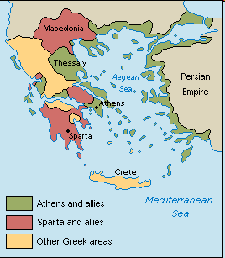

Slide 39
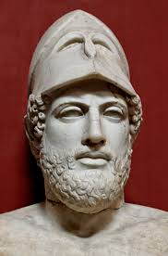
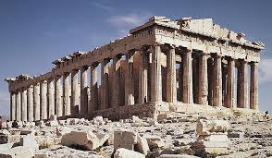
Golden Age of Pericles (mostly occurring between the Persian and the Peloponnesian Wars)
Pericles had Athens rebuilt after destruction in the Persian Wars; the Parthenon is an example of this reconstruction.
Pericles extended democracy; most adult males had an equal voice.
STANDARD WHI.5e
Athenian culture during the classical era became one of the foundation stones of Western civilization.

Slide 40
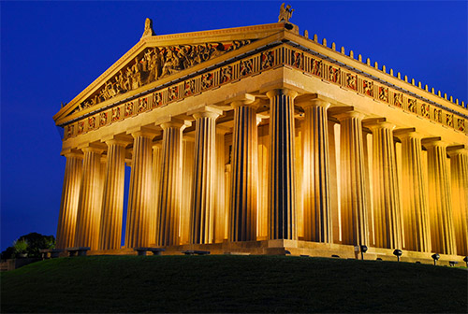
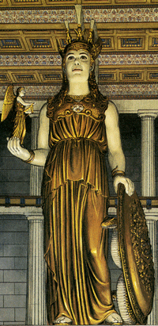
Parthenon

Slide 41
500
490
Persian Wars
499-449
b.c.
480
470
Golden Age of Pericles
461 to 429
460
450
440
Peloponnesian
War 431-404 b.c.
430
420
410
The Fifth Century B.C.
In Greece

Slide 42
Contributions of Greek culture to Western civilization
Architecture:
Types of columns, including the Doric (Parthenon), Ionic, and Corinthian
Drama:
Aeschylus, Sophocles
Poetry:
Homer (Iliad and Odyssey)
Science: Archimedes, Hippocrates
STANDARD WHI.5f
Athenian culture during the classical era became one of the foundation stones of Western civilization.
History: Herodotus, Thucydides
Philosophy:
Socrates, Plato, Aristotle
Mathematics: Euclid, Pythagoras
Sculpture:
Phidias

Slide 43
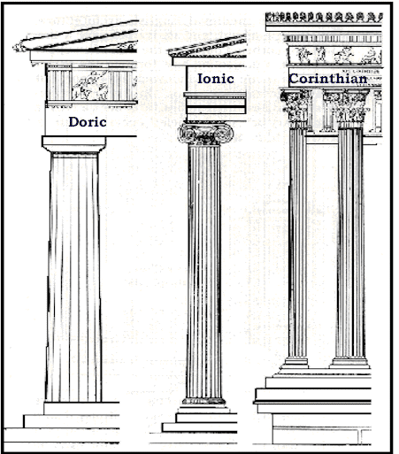
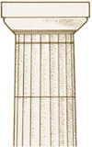
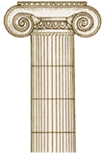

Slide 44
The Macedonian conquest of Greece followed the weakening of Greek defenses during the Peloponnesian Wars.
Alexander the Great adopted Greek culture and spread Hellenistic influences throughout his vast empire
Conquered most of Greece
Philip II, King of Macedon
Hellenistic Age
STANDARD WHI.5g
Blend of Greek and oriental elements
Spread of Hellenistic culture through trade
Alexander the Great
Established an empire from Greece to Egypt and the margins of India
Extended Greek cultural influences

Slide 46
The Romans
SOL #6

Slide 47
Rome: Centrally located in the Mediterranean Basin and distant from eastern Mediterranean powers
Italian Peninsula
Locations and places
Alps: Protection
Mediterranean Sea: Protection, sea-borne commerce
STANDARD WHI.6a
The city of Rome, with its central location on the Italian peninsula, was able to extend its influence over the entire Mediterranean Basin
.
The Italian peninsula was protected by the sea and the arc of the Alps mountains.

Slide 48
.
Roman mythology, like Greek
mythology, was based upon a
polytheistic religion that was integral to
culture, politics, and art.
Explanations of natural phenomena,
human qualities, and life events
Roman mythology
Many of Western civilization’s
symbols, metaphors, words, and
idealized images come from ancient
Roman mythology.
Based on the Greek polytheistic
religion
Roman gods and goddesses
STANDARD WHI.6b
Jupiter, Juno, Apollo, Diana,
Minerva, and Venus
Symbols and images in literature, art,
and architecture

Slide 49
Patricians: Powerful nobility (few in number)
Plebeians: Majority of population
Social structure in the Roman Republic
Slaves: Not based on race
Citizenship
STANDARD WHI.6c
Although women, most aliens (non-Romans living in the Republic), and slaves were excluded from the governing process, the Roman Republic made major strides in the development of representative democracy, which became a foundation of modern democracy.
Rights and responsibilities of citizenship (e.g., taxes, military service)
Patrician and plebeian men
Selected foreigners

Slide 50
.
Although women, most aliens (non-Romans living in the Republic), and slaves were excluded from the governing process, the Roman Republic made major strides in the development of representative democracy, which became a foundation of modern democracy.
Representative democracy
(Republic)
STANDARD WHI.6c
Assemblies
Consuls
(leaders of senate- 1 year term- there are 2)
The Senate
(The governing body)
Features of democracy
Laws of Rome codified as Twelve Tables

Slide 51
Rome and Carthage were in competition for trade.
Punic Wars: Rome vs. Carthage (264–146 b.c. [b.c.e.])
Hannibal invaded the Italian Peninsula.
Three wars resulted in Roman victory, the destruction of Carthage, and expanded trade and wealth for Rome.
STANDARD WHI.6d
After the victory over Carthage in the Punic Wars, Rome was able, over the next 100 years, to dominate the Mediterranean basin, leading to the diffusion of Roman culture.

Slide 52
After the victory over Carthage in the Punic Wars, Rome was able, over the next 100 years, to dominate the Mediterranean basin, leading to the diffusion of Roman culture.
STANDARD WHI.6d
Western Europe (Gaul (By Julius Caesar) , British Isles (by Claudius)
Mediterranean basin (Africa, Asia, Europe, including the Hellenistic world of the Eastern Mediterranean)
Evolution of the Roman Empire and spread of Roman culture

Slide 53
Spread of slavery in the agricultural system
Migration of small farmers into cities and unemployment
Causes for the decline of the Roman Republic
Civil war over the power of Julius Caesar
Devaluation of Roman currency; inflation
STANDARD WHI.6.e
The Roman Republic, in the face of changing social and economic conditions, succumbed to civil war and was replaced by an imperial regime, the Roman Empire.

Slide 54
Augustus Caesar: Civil war, defeat of Marc Anthony, Rome’s first emperor
Empire: Unified and enlarged, using imperial authority and the military
The origin and evolution of Imperial Rome
Failure to provide for peaceful succession of Emperors
The Roman Republic, in the face of changing social and economic conditions, succumbed to civil war and was replaced by an imperial regime, the Roman Empire.
Julius Caesar: Seizure of power, assassination
STANDARD WHI.6e
Caesar
Crassus
First triumvirate
First
triumvirate
Pompey
Augustus

Slide 55
100B.C.
100 B.C.- Birth of Caesar
60 B.C.
59 B.C.- 1st Triumvirate (Caesar, Crassus, Pompey the Great)
58 B.C – 51 B.C Caesar war in Gaul
90 B.C
50 B.C.
49 B.C.- 45 B.C. Civil War with Caesar and the Senate (Pompey)
48 B.C - The Battle of Pharsalus Caesar defeats Pompey
80 B.C.
43 B.C.- 33 B.C 2nd Triumvirate (Octavius , Lepidus, and Mark Antony)
42 BC - Octavian and Antony set out to war, defeating Brutus and Cassius in two battles fought at Battle of Philippi
40 B.C.
73- 71 B.C.- Spartacus slave rebellion
31 B.C -The Battle of Actium was the decisive confrontation of the Final War of the Roman Republic.
70 B.C.
30 B.C.
27 BC – Caesar Augustus becomes Emperor

Slide 56
Expansion and solidification of the Roman Empire, particularly in the Near East
Two centuries of peace and prosperity under imperial rule
The Pax Romana
Augustus Caesar established the Roman Empire by instituting civil service, rule by law, a common coinage, and secure travel and trade throughout the Empire.
Established uniform system of money, which helped to expand trade
STANDARD WHI.
Economic impact of the Pax Romana
Guaranteed safe travel and trade on Roman roads
Promoted prosperity and stability

Slide 57
Returned stability to social classes
Increased emphasis on the family
Social impact of the Pax Romana
Following Augustus Caesar, the Roman Empire enjoyed 200 years of peace and prosperity known as the Pax Romana.
STANDARD WHI.6.g
Political impact of the Pax Romana
Developed a uniform rule of law
Created a civil service

Slide 58
Was led by Jesus of Nazareth, who was proclaimed the Messiah
Had its roots in Judaism
Origins of Christianity
Conflicted with polytheistic beliefs of Roman Empire
STANDARD WHI.6h
The followers of Jesus spread Christianity throughout the Roman Empire, bringing it into conflict with Roman polytheism and eventually changing Western civilization.

Slide 59
The followers of Jesus spread Christianity throughout the Roman Empire, bringing it into conflict with Roman polytheism and eventually changing Western civilization.
Christian doctrines established by early church councils
New Testament, containing accounts of the life and teachings of Jesus, as well as writings of early Christians
STANDARD WHI.6h
Jesus as both Son and incarnation of God
Beliefs, traditions, and customs of Christianity
Life after death
Monotheism

Slide 60
Popularity of the message
Early martyrs inspired others
Spread of Christianity
Carried by the Apostles, including Paul, throughout the Roman Empire
STANDARD WHI.6h
The followers of Jesus spread Christianity throughout the Roman Empire, bringing it into conflict with Roman polytheism and eventually changing Western civilization.

Slide 61
As the Roman Empire declined in the West, the Church of Rome grew in importance, followers, and influence.
The Emperor Constantine converted to Christianity and made it legal.
The Church became the main unifying force of Western Europe.
STANDARD WHI.6i
The Church became a source of moral authority
Loyalty to the Church became more important than loyalty to the Emperor.
Impact of the Church of Rome in the late Roman Empire
Christianity later became the official state religion.

Slide 62
Art and architecture: Pantheon, Coliseum, Forum
Medicine: Emphasis on public health (public baths, public water systems, medical schools)
Contributions of ancient Rome
Technology: Roads, aqueducts, Roman arches
Language: Latin, Romance languages
STANDARD WHI.6j
Literature: Virgil’s Aeneid
Conquests and trade spread Roman cultural and technological achievements throughout the Empire.
Western civilization was influenced by the cultural achievements of Rome.
Science: Achievements of Ptolemy
Law:
The principle of “innocent until proven guilty” (from the Twelve Tables)
Religion: Roman mythology; adoption of Christianity as the imperial religion

Slide 63
Pantheon

Slide 64
Colosseum

Slide 65
Roman Forum

Slide 66
Roman roads

Slide 67
Aqueducts

Slide 68
Roman arches

Slide 69
Roman public baths

Slide 70
Twelve Tables of Rome

Slide 71
Geographic size: Difficulty of defense and administration
Economy: The cost of defense, and devaluation of Roman currency
Causes for the decline of the Western Roman Empire
Military: Army membership started to include non-Romans, resulting in decline of discipline
Moral decay: People’s loss of faith in Rome and the family
STANDARD WHI.6k
Political problems: Civil conflict and weak administration
Invasion: Attacks on borders
Over a 300 year period, the western part of the Roman Empire steadily declined because of internal and external problems.

Slide 72
Survival of the Western Roman Empire until 476 a.d. (c.e.), when it ceased to have a Roman Emperor
Move of the capital by Constantine from Rome to Byzantium, renaming it Constantinople
Division of the Roman Empire
Eastern Roman Empire (Byzantine Empire)
Over a 300 year period, the western part of the Roman Empire steadily declined because of internal and external problems.
STANDARD WHI.6k

Slide 73
Baltic Sea
Britain
Dardanelles Straits
Alps
Gaul
Atlantic
Ocean
Rome
Balkan
Peninsula
Black Sea
*
*
Constantinople
Spain
*
Asia Minor
*
Athens
Carthage
Mediterranean Sea
*
Jerusalem

Slide 74
Protection of the eastern frontier
Distance from Germanic invasions in the western empire
Location of Constantinople
Easily fortified site on a peninsula bordered by natural harbors
Crossroads of trade
STANDARD WHI.7a
The capital of the Eastern Roman Empire was changed to Constantinople to provide political, economic, and military advantages.

Slide 75
The Byzantines!
SOL #7

Slide 76
Seat of the Byzantine Empire until Ottoman conquest
Preserved classical Greco-Roman culture
Role of Constantinople
Center of trade
STANDARD WHI.7a
The capital of the Eastern Roman Empire was changed to Constantinople to provide political, economic, and military advantages.

Slide 77
Codification of Roman law (impact on European legal codes)
Expansion of trade
Byzantine Emperor Justinian
Reconquest of former Roman territories
STANDARD WHI.7b
As the first to codify Roman law, Justinian provided the basis for the law codes of Western Europe.
Under Justinian, the Byzantine Empire reached its height in culture and prosperity.

Slide 78
Greek Orthodox Christianity and imperial patronage enabled the Byzantine Empire to develop a unique style of art and of architecture.
Hagia Sophia (a Byzantine domed church)
STANDARD WHI.7c
Icons (religious images)
Byzantine achievements in art and architecture
Inspiration provided by Christian religion and imperial power
Mosaics in public and religious structures

Slide 79
Hagia Sophia

Slide 80
Continued flourishing of Greco-Roman traditions
Greek language (as contrasted with Latin in the West)
Byzantine culture
Greek and Roman knowledge preserved in Byzantine libraries
Greek Orthodox Christianity
STANDARD WHI.7c
Greek and Roman traditions were preserved in the Byzantine Empire.

Slide 81
Farther from seat of power after Constantinople became capital
Centered in Rome
Western Church
The cultural and political differences between the Eastern and Western Roman Empires weakened the unity of the Christian Church and led to its division.
Use of Latin language in the liturgy
STANDARD WHI.7d
Close to seat of power after Constantinople became capital
Use of Greek language in the liturgy
Centered in Constantinople
Eastern Church

Slide 82
Practices such as celibacy eventually accepted in the West
Authority of the Patriarch accepted in the East
Division between Western and Eastern Churches
Authority of the Pope eventually accepted in the West
STANDARD WHI.7d
The cultural and political differences between the Eastern and Western Roman Empires weakened the unity of the Christian Church and led to its division.

Slide 84
Byzantine civilization influenced Russian and Eastern European civilizations through its religion, culture, and trade.
Adoption of Greek alphabet for the Slavic languages by St. Cyril (Cyrillic alphabet)
STANDARD WHI.7e
Church architecture and religious art
Influence of Byzantine culture on Eastern Europe and Russia
Adoption of Orthodox Christianity by Russia and much of Eastern Europe
Trade routes between Black Sea and Baltic Sea

Slide 85
Moscow
Baltic Sea
*
Russia
England
France
Dardanelles straits
Atlantic
Balkan
Peninsula
Black Sea
Rome
*
*
Constantinople
Spain
Aegean
Sea
Asia Minor
*
Carthage
Tigris River
Mediterranean
Sea
Nile River Delta
Euphrates River
Jerusalem
*
Nile River
Egypt

