Slide 1
The Religion of Islam!
SOL #8

Slide 2
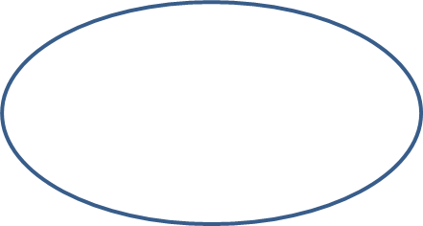
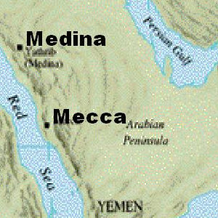
Mecca and Medina on the Arabian Peninsula: Early Muslim cities
Muhammad, the Prophet
Origins of Islam
The revelations of Muhammad form the basis of the Islamic religion, a monotheistic faith.
STANDARD WHI.8a
Across Asia and Africa and into Spain
Spread of Islam
Geographic extent of first Muslim empire

Slide 3
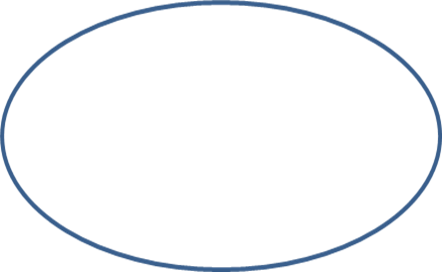
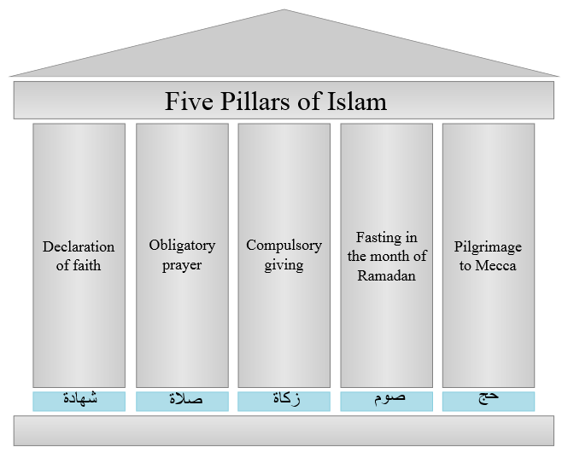
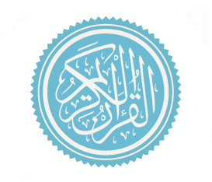
Acceptance of Judeo-Christian prophets, including Moses and Jesus
Monotheism: Allah (Arabic word for God)
Beliefs, traditions, and customs of Islam
Five Pillars of Islam
Qur’an (Koran): The word of God
STANDARD WHI.8a
Muhammad and his followers spread Islam.
Islamic traditions and customs developed over centuries and created a distinctive Muslim culture.

Slide 4
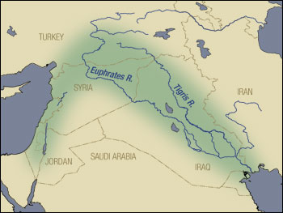
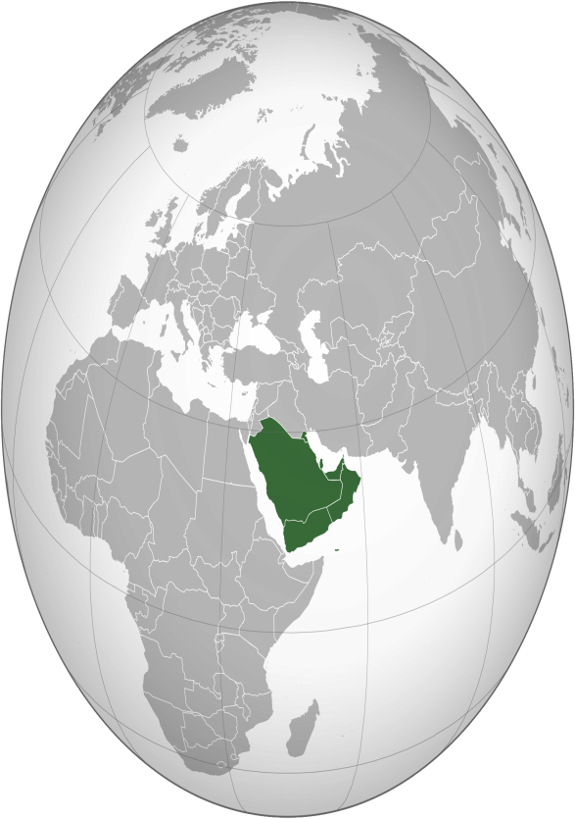
In the first three centuries after Muhammad’s death, Muslim rule expanded rapidly, overcoming geographic barriers, and facilitated by weakened political empires.
Spread into the Fertile Crescent, Iran, and Central Asia facilitated by weak Byzantine and Persian empires
STANDARD WHI.8b
Geographic influences on the origin and spread of Islam
Diffusion along trade routes from Mecca and Medina
Expansion despite great distances, desert environments, and mountain barriers

Slide 5
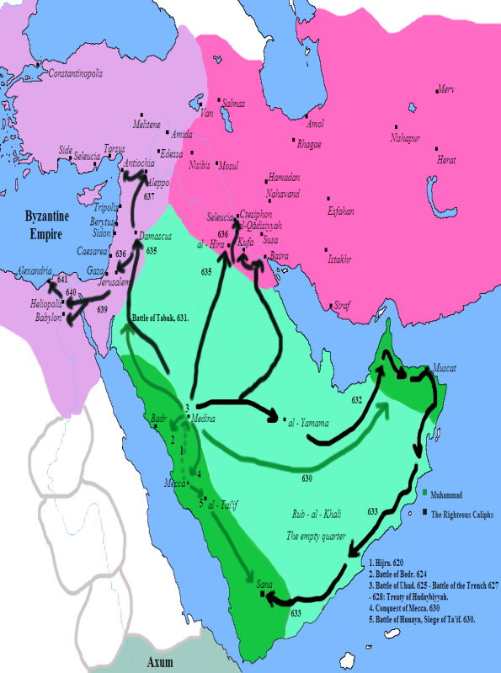
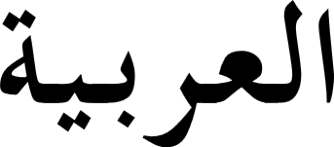
Political unity of the first Muslim empire was short-lived.
Geographic influences on economic, social, and political development
Slavery was not based on race.
Arabic language spread with Islam and facilitated trade across Islamic lands.
STANDARD WHI.8b
Political unity and the Arabic language facilitated trade and stimulated intellectual activity.

Slide 6
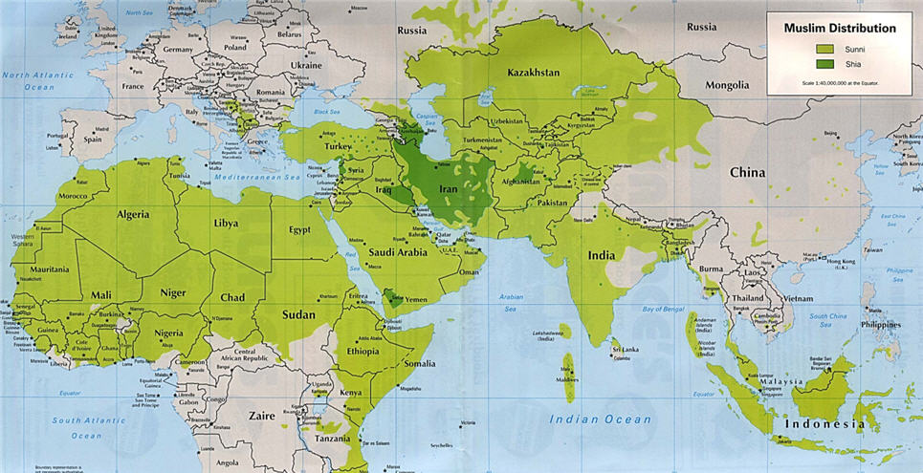
Major historical turning points marked the spread and influence of Islamic civilization.
Death of Ali: Sunni-Shi’a division
Muslim defeat at the Battle of Tours
STANDARD WHI.8c
Muslim conquests of Jerusalem and Damascus
Historical turning points
Islamic capital moved to Baghdad
Fall of Baghdad to the Mongols

Slide 7
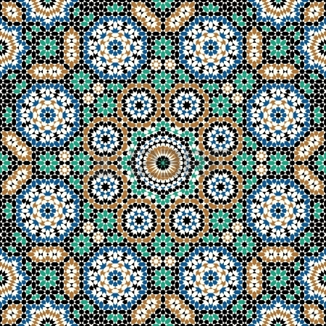
Architecture (Dome of the Rock)
Cultural contributions and achievements
Universities
Arabic alphabet
STANDARD WHI.8d
Mosaics
Early Islamic civilization was characterized by achievements in science and the arts that transformed the Islamic world and contributed to world civilization.
Translation of ancient texts into Arabic

Slide 8
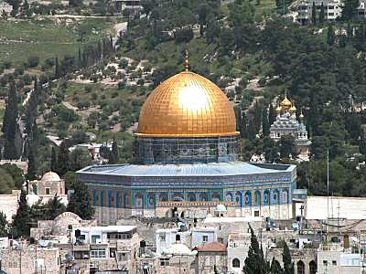
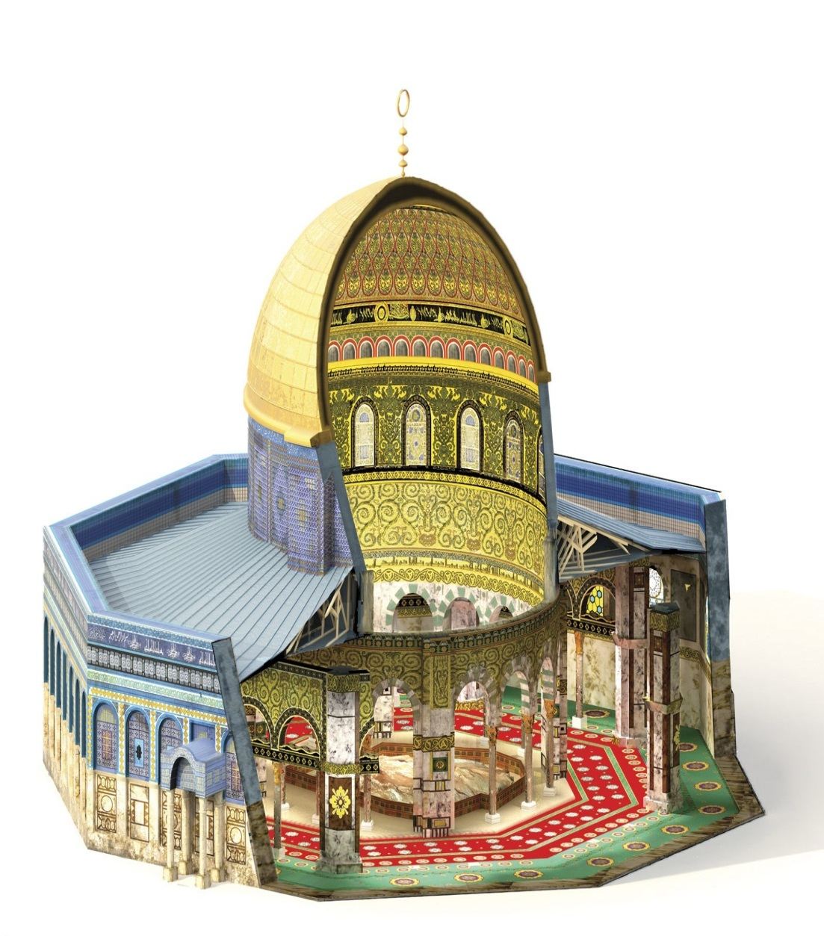
Dome of the Rock

Slide 9
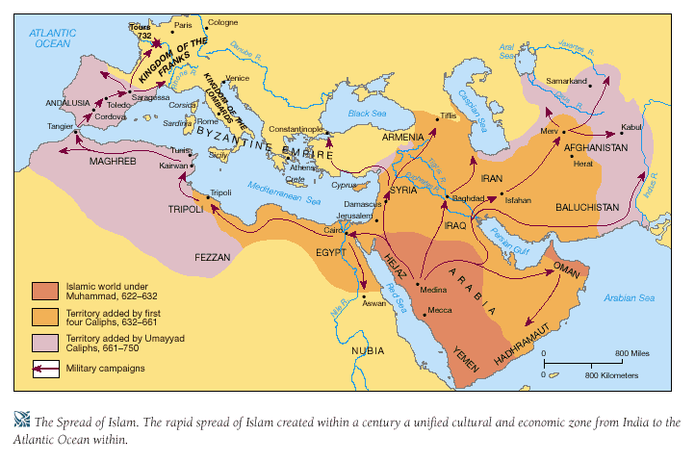
Early Islamic civilization was characterized by achievements in science and the arts that transformed the Islamic world and contributed to world civilization.
Arabic numerals (adapted from India, including zero)
STANDARD WHI.8d
Expansion of geographic knowledge
Scientific contributions and achievements
Medicine
Algebra

Slide 10
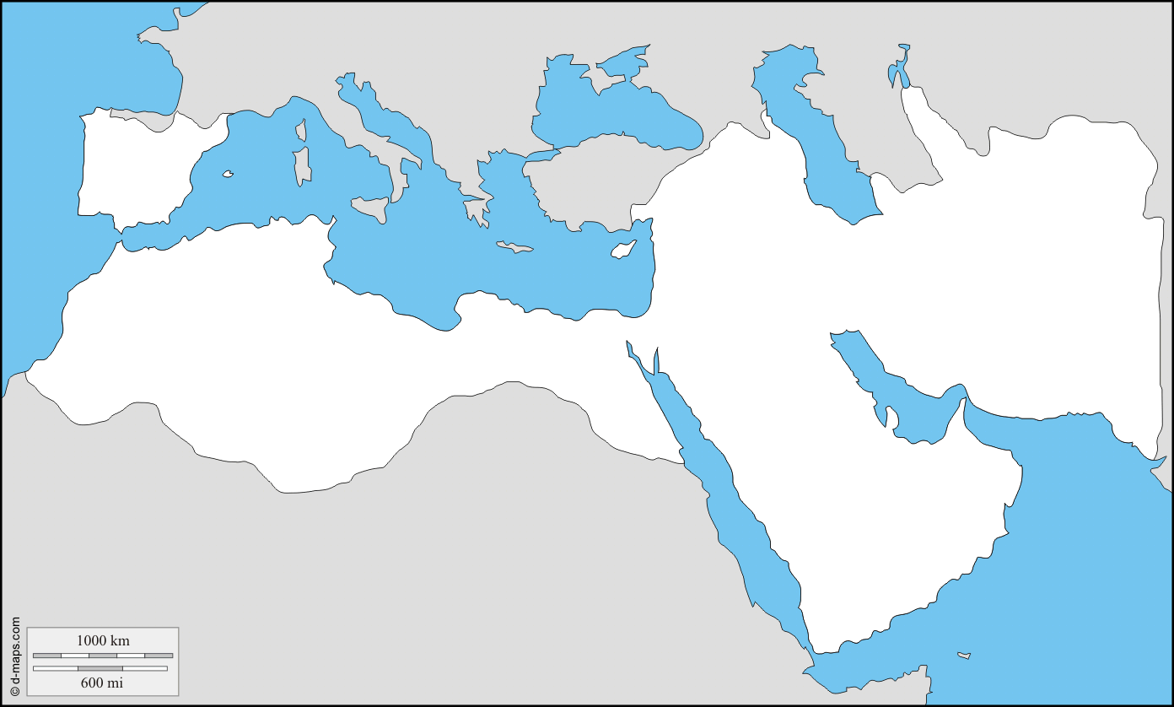
Tours
*
Alps
Balkan
Peninsula
Black Sea
*
Constantinople
Rome
*
Aegean
Sea
Asia
Minor
Atlantic
Mediterranean
Sea
Damascus
*
*
Baghdad
*
Jerusalem
*
Medina
*
Mecca
Arabian
Peninsula

Slide 11
The Middle Ages In Europe!
SOL #9

Slide 12
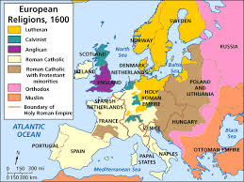
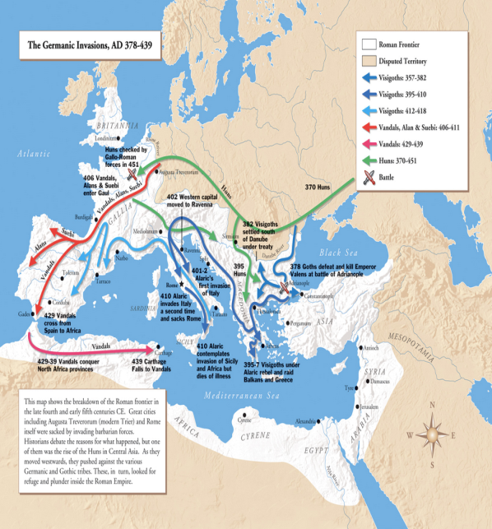
Classical heritage of Rome
Foundations of early medieval society
Christian beliefs
Customs of Germanic tribes
STANDARD WHI.9a
The Roman Catholic Church grew in importance after Roman authority declined. It became the unifying force in western Europe.

Slide 13
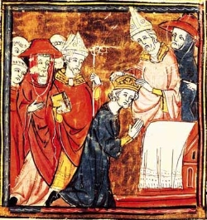
During the Middle Ages, the Pope anointed the Emperors, missionaries carried Christianity to the Germanic tribes, and the Church served the social, political, and religious needs of the people.
Missionaries carried Christianity and Latin alphabet to Germanic tribes.
Parish priests served religious and social needs of the people.
The Pope anointed Charlemagne Emperor in 800 a.d. (c.e.)
STANDARD WHI.9a
Influence of the Roman Catholic Church
Monasteries preserved Greco-Roman cultural achievements.
Secular authority declined, while Church authority grew.

Slide 14
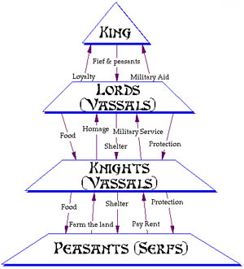
Feudal society during the Middle Ages
Invasions shattered Roman protection over the Empire.
Fiefs
Vassals
Serfs
Feudal obligations
STANDARD WHI.9b
The decline of Roman influence in Western Europe left people with little protection against invasion, so they entered into feudal agreements with landholding lords who promised them protection
Manorial system during the Middle Ages
Rigid class structure
Self-sufficient manors

Slide 15
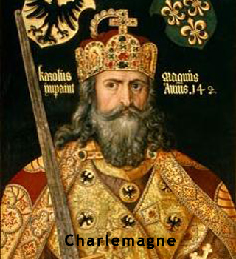
Franks emerged as a force in Western Europe.
Most of Western Europe was included in the new empire.
Age of Charlemagne
The Pope crowned the Emperor.
Churches, roads, and schools were built to unite the empire.
STANDARD WHI.9c
Power of the Church was established in political life.
Frankish kings used military power to expand their territory.
The alliance between Frankish kings and the Church re-established Roman culture (Christianity) in Western Europe
Roman culture was reinterpreted.

Slide 16
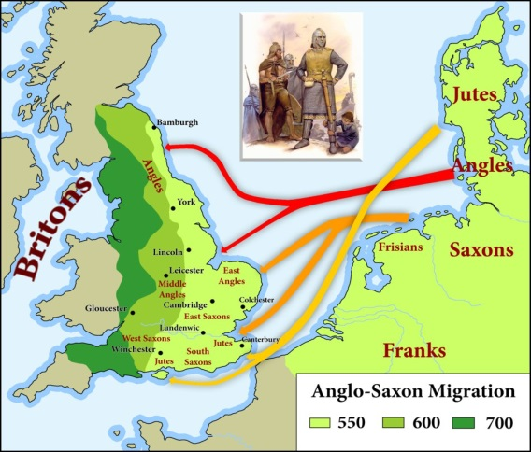
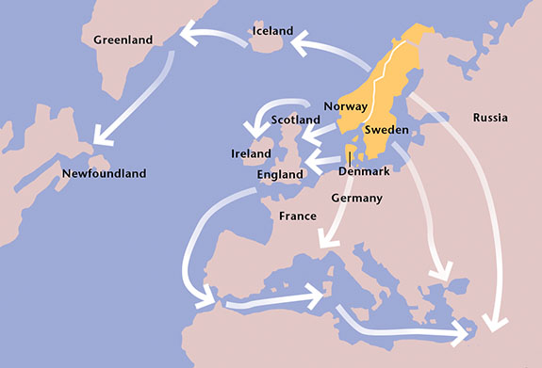
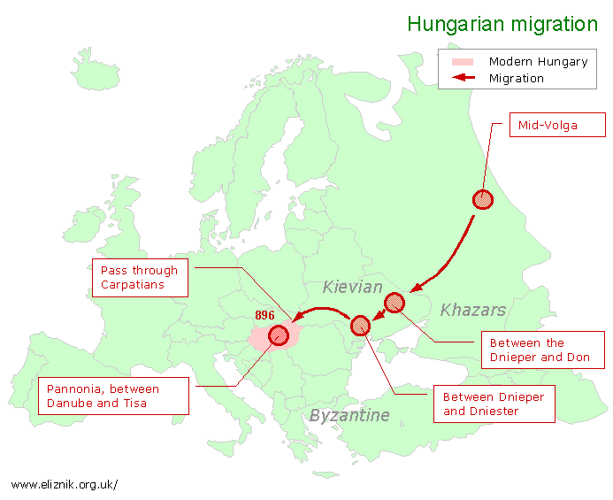
Invasions by Angles, Saxons, Magyars, and Vikings disrupted the social, economic, and political order of Europe.
Angles and Saxons migrated from continental Europe to England.
STANDARD WHI.9d
Vikings migrated from Scandinavia to Russia.
Areas of settlement
Magyars migrated from Central Asia to Hungary.

Slide 17
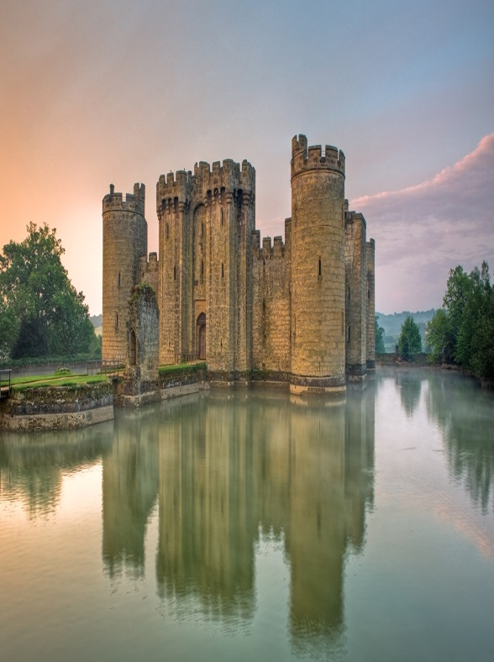
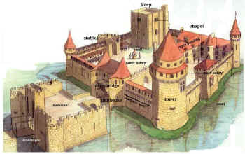
Manors with castles provided protection from invaders, reinforcing the feudal system.
Invasions disrupted trade, towns declined, and the feudal system was strengthened.
Influence of the Angles, Saxons, Magyars, and Vikings
STANDARD WHI.9d
Invasions by Angles, Saxons, Magyars, and Vikings disrupted the social, economic, and political order of Europe.

Slide 18
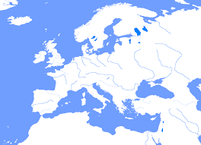
Artic Ocean
Scandinavia
Baltic Sea
Russia
England
Atlantic
France
(Franks)
Alps
Black Sea
Muslim
Moors
Asia Minor
Tigris River
Mediterranean Sea
Euphrates River
Nile River

Slide 19
The Medieval Trade routes and Asia!
SOL #10

Slide 20
Silk Routes across Asia to the Mediterranean basin
Maritime routes across the Indian Ocean
Major trade patterns of the Eastern Hemisphere from 1000 to 1500 a.d. (c.e.)
Trans-Saharan routes across North Africa
Northern European links with the Black Sea
STANDARD WHI.10a
During the medieval period, several major trading routes developed in the Eastern Hemisphere. These trading routes developed among Europe, Africa, and Asia.
Western European sea and river trade
South China Sea and lands of Southeast Asia

Slide 21
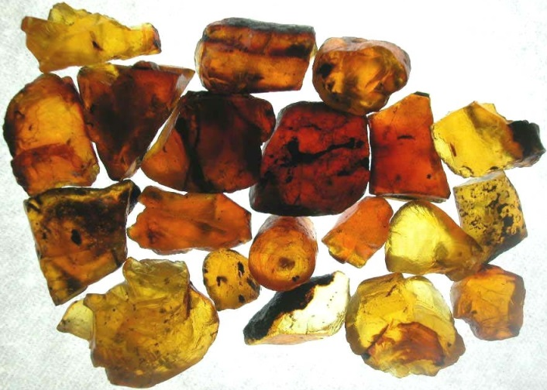
Regional trade networks and long-distance trade routes in the Eastern Hemisphere aided the diffusion and exchange of technology and culture among Europe, Africa, and Asia.
Amber from the Baltic region
Textiles from India, China, the Middle East, and later Europe
STANDARD WHI.10b
Porcelain from China and Persia
Goods
Spices from lands around the Indian Ocean
Gold from West Africa

Slide 22
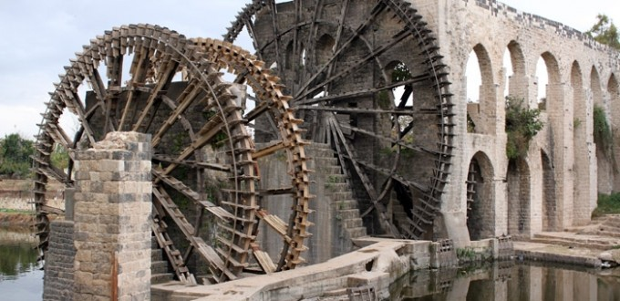
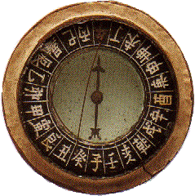
Paper from China through the Muslim world to Byzantium and Western Europe
New crops from India (e.g., for making sugar)
Technology
Waterwheels and windmills from the Middle East
Navigation: Compass from China, lateen sail from Indian Ocean region
STANDARD WHI.10b
Regional trade networks and long-distance trade routes in the Eastern Hemisphere aided the diffusion and exchange of technology and culture among Europe, Africa, and Asia.

Slide 23
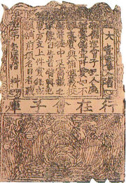
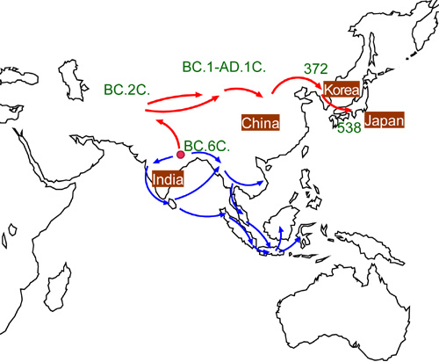
Spread of religions across the hemisphere
Printing and paper money from China
Ideas
Buddhism from China to Korea and Japan
Hinduism and Buddhism from India to Southeast Asia
Islam into West Africa, Central and Southeast Asia
STANDARD WHI.10b
Regional trade networks and long-distance trade routes in the Eastern Hemisphere aided the diffusion and exchange of technology and culture among Europe, Africa, and Asia.

Slide 24
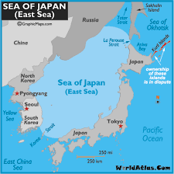
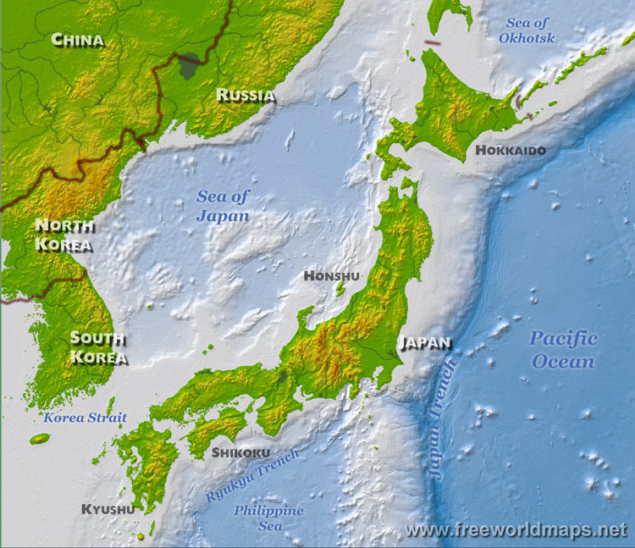
Japanese cultural development was influenced by proximity to China.
STANDARD WHI.10c
Sea of Japan or East Sea between Japan and Asian mainland
Location and place
Mountainous Japanese archipelago (four main islands)
Proximity to China and Korea

Slide 25
Writing
Architecture
Buddhism
Influence of Chinese culture
Coexistence with Buddhism
Shinto and Buddhism coexisted as religious traditions in the Japanese culture
STANDARD WHI.10c
State religion; worship of the emperor
Importance of natural features, forces of nature, and ancestors
Shinto
Ethnic religion unique to Japan

Slide 26
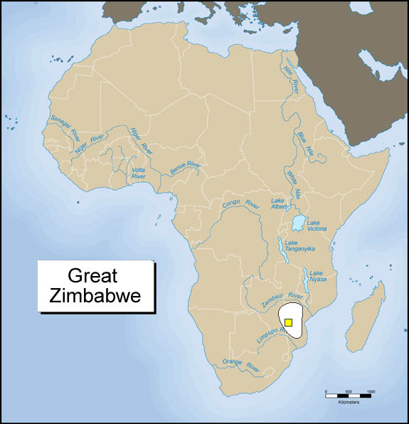
Location relative to the Ethiopian Highlands and the Nile River
Christian kingdom
Axum
African civilizations developed in sub-Saharan west and east Africa.
Trade brought important economic, cultural, and religious influences to African civilizations from other parts of the Eastern Hemisphere.
STANDARD WHI.10d
Location relative to the Zambezi and Limpopo rivers and the Indian Ocean coast
Zimbabwe
City of “Great Zimbabwe” as capital of a prosperous empire

Slide 27
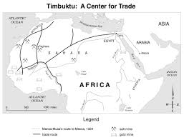
Location of Ghana, Mali, and Songhai empires relative to Niger River and the Sahara
Roles of animism and Islam
West African kingdoms
Importance of gold and salt to trans-Saharan trade
City of Timbuktu as center of trade and learning
STANDARD WHI.10d
States and empires flourished in Africa during the medieval period, including Ghana, Mali, and Songhai in west Africa, Axum in east Africa, and Zimbabwe in southeastern Africa.

Slide 28
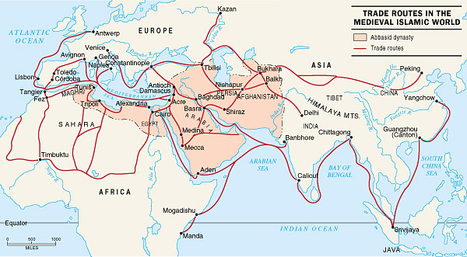

Slide 29
Early America!
SOL #11

Slide 30
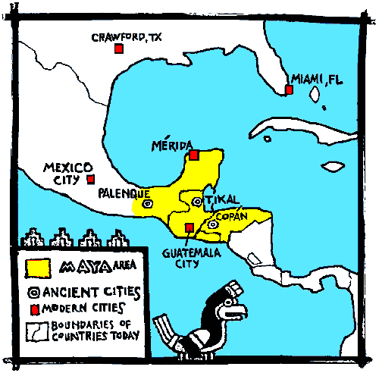
Located in the Mexican and Central American rain forests
Economy based on agriculture and trade
Mayan cavitation
Represented by Chichén Itzá
Polytheistic religion: Pyramids
STANDARD WHI.11a
The Mayan, Aztec, and Incan civilizations emerged in South America, Central America, and Mexico.
Groups of city-states ruled by kings

Slide 31
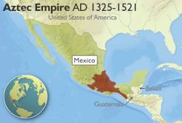
Located in arid valley in central Mexico
Represented by Tenochtitlan
Aztec civilization
Polytheistic religion: Pyramids, rituals
Ruled by an emperor
STANDARD WHI.11a
The Mayan, Aztec, and Incan civilizations emerged in South America, Central America, and Mexico.
Economy based on agriculture and tribute from conquered peoples

Slide 32
Located in the Andes Mountains of South America
Represented by Machu Picchu
Incan civilization
Ruled by an emperor
Economy based on high-altitude agriculture
STANDARD WHI.11a
The Mayan, Aztec, and Incan civilizations emerged in South America, Central America, and Mexico.
Road system
Polytheistic religion

Slide 33
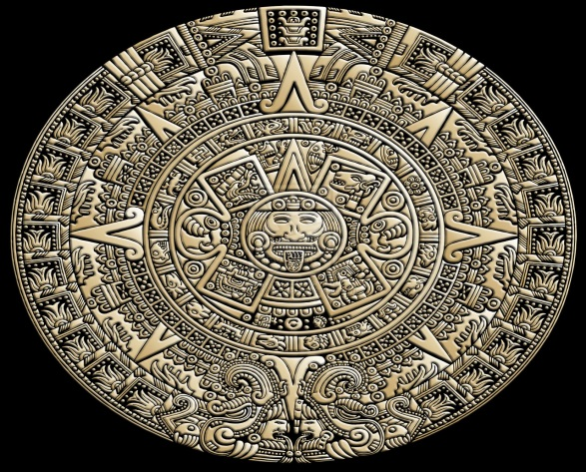
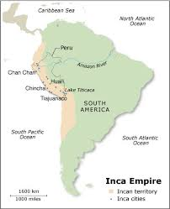
The Mayan, Aztec, and Incan civilizations emerged in South America, Central America, and Mexico.
STANDARD WHI.11b
Calendars
Achievements of Mayan, Aztec, and Incan civilizations
Writing and other record-keeping systems
Mathematics

Slide 34
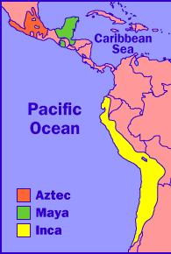

Slide 35
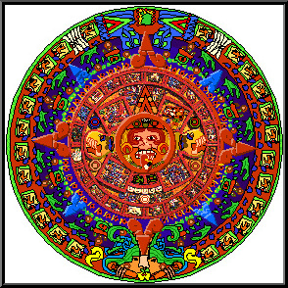
Calendars
Mathematics
Achievements of Mayan, Aztec, and Incan civilizations
Writing and other record-keeping systems
STANDARD WHI.11b
The Mayan, Aztec, and Incan civilizations emerged in South America, Central America, and Mexico.

Slide 36
Late Medieval Period!
SOL #12

Slide 37
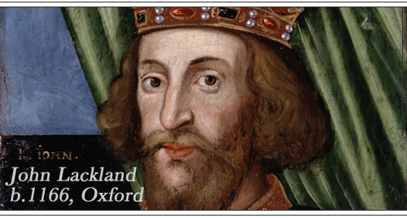
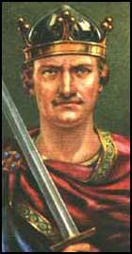
William the Conqueror, leader of the Norman Conquest, united most of England.
Common law had its beginnings during the reign of Henry II.
England
King John signed the Magna Carta, limiting the king’s power.
STANDARD WHI.12a
European monarchies consolidated their power and began forming nation-states in the late medieval period.
The Hundred Years’ War between England and France helped define England as a nation
Evolution of Parliament.

Slide 38
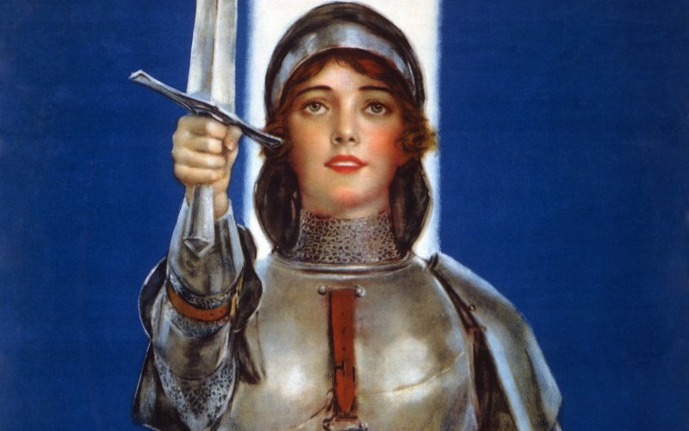
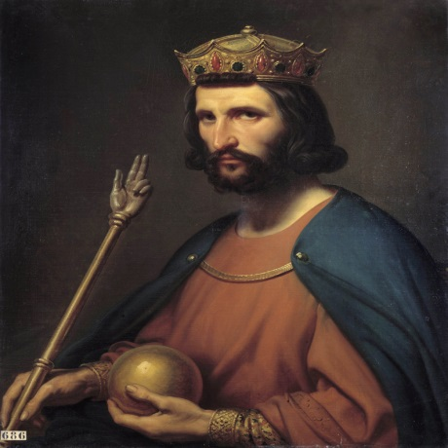
Joan of Arc was a unifying factor.
The Hundred Years’ War between England and France helped define France as a nation.
France
Hugh Capet established the French throne in Paris, and his dynasty gradually expanded their control over most of France.
STANDARD WHI. 12a
European monarchies consolidated their power and began forming nation-states in the late medieval period.

Slide 39
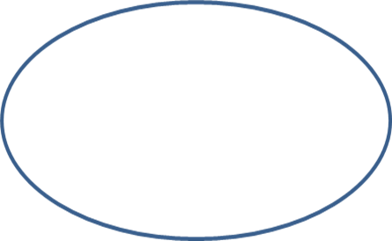
Ferdinand and Isabella unified the country and expelled Jews and Moors.
Spanish Empire in the Western Hemisphere expanded under Charles V.
Spain
European monarchies consolidated their power and began forming nation-states in the late medieval period.
Power was centralized in the hands of the tsar.
STANDARD WHI. 12a
Ivan the Great threw off the rule of the Mongols, centralized power in Moscow, and expanded the Russian nation.
Russia
The Orthodox Church influenced unification.

Slide 40
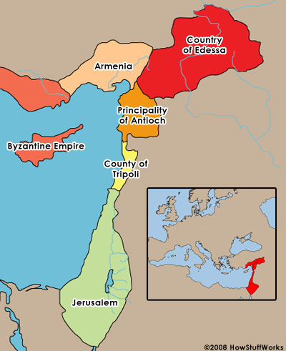
Crusades were carried out by Christian political and religious leaders to take control of the Holy Land from the Muslims.
Pope Urban’s speech
The capture of Jerusalem
STANDARD WHI. 12b
Founding of Crusader states
Loss of Jerusalem to Saladin
Key events of the Crusades
Sack of Constantinople by western Crusaders

Slide 41
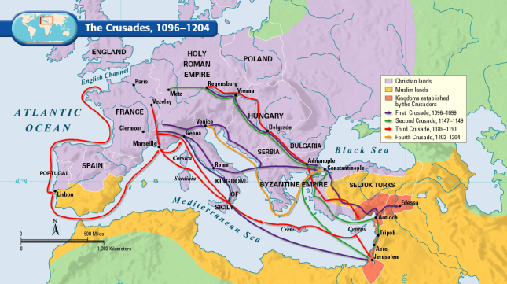

Slide 42
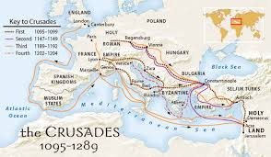
Weakened the Pope and nobles; strengthened monarchs
Effects of the Crusades
Weakened the Byzantine Empire
Stimulated trade throughout the Mediterranean area and the Middle East
STANDARD WHI.12b
Crusades were carried out by Christian political and religious leaders to take control of the Holy Land from the Muslims.
Left a legacy of bitterness among Christians, Jews, and Muslims

Slide 43
Mongol armies invaded Russia, Southwest Asia, and China, creating an empire.
STANDARD WHI. 12b
Invaded Russia, China, and Muslim states in Southwest Asia, destroying cities and countryside
Mongol armies
Created an empire

Slide 45
Fell to the Ottoman Turks in 1453, ending the Byzantine Empire
Became capital of the Ottoman Empire
Constantinople
STANDARD WHI.12b
Ottoman Turks conquered the Byzantine Empire.

Slide 47
In the fourteenth century, the Black Death (Bubonic plague) decimated the population of much of Asia and then the population of much of Europe.
Disruption of trade
STANDARD WHI.12c
Decline of Church influence
Towns freed from feudal obligations
Decline in population
Impact of the Black Death (Bubonic plague)
Scarcity of labor

Slide 49
Were among the very few who could read and write
Made new knowledge in philosophy, medicine, and science available in Europe
Church scholars
Laid the foundations for the rise of universities in Europe
Worked in monasteries
STANDARD WHI. 12d
Education was largely confined to the clergy during the Middle Ages. The masses were uneducated, while the nobility was concerned with feudal obligations. Church scholars preserved ancient literature in monasteries in the East and West.
Translated Greek and Arabic works into Latin

Slide 50
The Renaissance in Europe!
SOL #13

Slide 51
Increased demand for Middle Eastern products
Encouraged the use of credit and banking
Economic effects of the Crusades
Stimulated production of goods to trade in Middle Eastern markets
STANDARD WHI. 13a
The Crusades stimulated trade by introducing Europeans to many desirable products.

Slide 52
Trade promoted frequent contacts with the Byzantine and Muslim Empires.
New economic institutions developed.
New accounting and bookkeeping practices (use of Arabic numerals) were introduced.
STANDARD WHI .13a
Church rule against usury and the banks’ practice of charging interest helped to secularize northern Italy.
Letters of credit served to expand the supply of money and expedite trade.
Important economic concepts

Slide 53
Had access to trade routes connecting Europe with Middle Eastern markets
Florence, Venice, and Genoa
Served as trading centers for the distribution of goods to northern Europe
STANDARD WHI. 13b
Wealth accumulated from European trade with the Middle East led to the rise of Italian city-states. Wealthy merchants were active civic leaders.
Were initially independent city-states governed as republics

Slide 54
Machiavelli observed city-state rulers of his day and produced guidelines for the acquisition and maintenance of power by absolute rule.
An early modern treatise on government
STANDARD WHI. 13b
Supports absolute power of the ruler
Advises that one should not only do good if possible, but do evil when necessary
Maintains that the end justifies the means
Machiavelli’s The Prince

Slide 55
Michelangelo: Ceiling of the Sistine Chapel and David
Leonardo da Vinci: Mona Lisa and The Last Supper
Artistic and literary creativity
Petrarch: Sonnets, humanist scholarship
STANDARD WHI.13c
The Renaissance produced new ideas that were reflected in the arts, philosophy, and literature. Patrons, wealthy from newly expanded trade, sponsored works that glorified city-states in northern Italy. Education became increasingly secular.
Medieval art and literature focused on the Church and salvation, while Renaissance art and literature focused on individuals and worldly matters, along with Christianity.

Slide 59
The Renaissance produced new ideas that were reflected in the arts, philosophy, and literature. Patrons, wealthy from newly expanded trade, sponsored works that glorified city-states in northern Italy. Education became increasingly secular.
Celebrated the individual
Stimulated the study of classical Greek and Roman literature and culture
STANDARD WHI.13c
Supported by wealthy patrons
Humanism

Slide 60
The movable type printing press and the production and sale of books (e.g., Gutenberg Bible) helped disseminate ideas.
Northern Renaissance
Northern Renaissance thinkers merged humanist ideas with Christianity.
STANDARD WHI.13d
With the rise of trade, travel, and literacy, the Italian Renaissance spread to northern Europe. The art and literature of the Italian Renaissance changed as people of different cultures adopted Renaissance ideas.
Growing wealth in Northern Europe supported Renaissance ideas.

Slide 61
Erasmus: The Praise of Folly (1511)
Northern Renaissance writers
Sir Thomas More: Utopia (1516)
STANDARD WHI.13d
With the rise of trade, travel, and literacy, the Italian Renaissance spread to northern Europe. The art and literature of the Italian Renaissance changed as people of different cultures adopted Renaissance ideas.
Northern Renaissance artists portrayed religious and secular subjects.

